Slide 2
This presentation is for the kids who set off to school intending to learn to read and write, but falter because of an unexpected learning difficulty, namely Dyslexia, Dysgraphia, Dyscalculia, or all of them
Notes:
180
Ask most littlies before they head off to school want they want to learn.
They’ll tell you that they want to learn to read. Many have watched their mum or dad do it, and most have gained pleasure over the years as they’ve listened to their mother of father read to them.
Now they want to do it themselves.
They also want to learn how to break that annoying code that mum or dad uses – you know, when parents spell words out loud in front of kids so they don’t know what they’re talking about.
Soon after starting school they realise their learning is not the same as the others. The others scoot through the glorified reading boxes, while they struggle to retain word patterns and sounds. They burn with frustration and/or humiliation because they can’t access the most valuable currency in schools – that marvellous capacity to efficiently process PRINT .
This wasn’t their dream.

Slide 3
“I don’t want to be here anymore…” (to 3:02)
https://www.youtube.com/watch?v=xqhTFuDG6KI
Notes:
300
Here’s Tim’s story, and how he chose to cope with his dyslexia at age 7 …
After the film clip…
Could this have been predicted; yes!
Could it have been prevented; double yes!
We need some serious paradigm shifts
Why is Dyslexia recognised as a disability in the community, but not in supposedly humane places we call schools?
Why is it that most state school systems psychologists are still encouraged by the government not to mention the D-Word (Dyslexia)?
Why is it there is no systematic training of teachers at undergraduate level to understand dyslexia, how to identify it or knowhow to work with it?
Why is it that most teachers don’t understand dyslexia, how to identify it or know how to work with it?
But, it gets worse. Just ask teachers. Most ‘do’ reading with kids. They don’t teach it. They don’t know how to teach it. Instead they rely on most kids twigging to it.
Why is it that most teachers are not familiar with the current reading research?
Why is it that most teachers are unsure what a systematic reading approach means or looks like?
The final paradigm shift – and it’s one you can help with - is that we need every adult who cares for kids - to be a ‘dibber-dobber’ on kids who are having trouble acquiring their reading skills – especially in the early years.
Let’s do away with educators saying to parents;
“Don’t worry, his reading will come together.”
“It’s alright, boys take longer to read.”
“Let him read at his own level”
When kids are struggling to read it is not alright - at this point we need to assume that they’re in trouble - let’s not wait for the first NAPLAN test in year 3 – that’s too late!
The research is patently clear– it tells us that any child who remains stuck on reading during the first 3 years of school has a very poor chance of completing secondary school.

Slide 4
Notes:
A dreadful shame slowly replaces their dream to read and write….
So, when mum drags them into your rooms because she’s worried about them; what are you likely to see?
A few turn their shame inwards. So, they may have already disengaged and stop trying at school.
Mum may say they’ve become quiet, distant or withdrawn, are losing interest in friendships, avoid reading and avoid homework, have tummy aches before school and some days just refuse to go to school. A separation style anxiety seems to be developing.
Others present as sad, and despite being young have already become depressed and talk about “killing themselves”. Because they see it as a better option than dealing with their shame and humiliation, in front of peers, every day.
For those with a propensity to act out their shame, well, the script plays out with great speed as they perfect eruptive emotion and errant behaviour.
Not being able to crack the PRINT CODE still hurts, but at least they gain recognition for something.

Slide 5
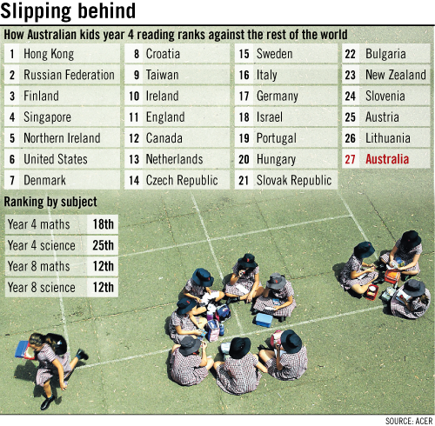
2011 Progress in International Reading Literacy Study (PIRLS)
Notes:
Approximately 16% of Australian children have difficulties learning to read (Westwood, 2001).
Poor reading ability = significant negative consequences
Dyslexia, or Specific Reading Disability (SRD), is a disorder that may be defined as significant difficulty with reading and writing compared to other cognitive abilities, despite adequate opportunity to learn.
Despite considerable gains in our understanding of the disorder in the past two decades, outstanding questions remain regarding the underlying cause of reading difficulties.

Slide 6
We have a problem in Australia
www.fivefromfive.org.au

Slide 7
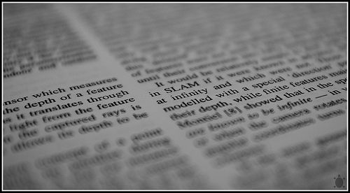
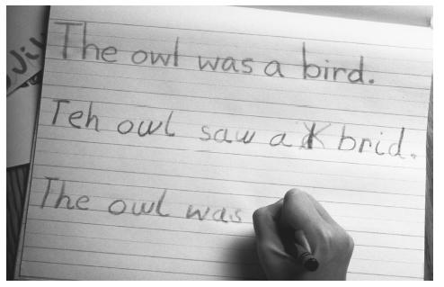
A glimpse into the agony
The secret life of the dyslexic child
have a conversation about the possible reasons Australia’s reading results have fallen to be among the lowest of developed English speaking countries
Do not use any words with the sounds /f/ or /t/.
Notes:
The secret life of the dyslexic child (120)
have a conversation with the person next about your thoughts on the National Curriculum and what it has so offer students and families. Do not use any words with the letter ‘f’ or ‘t’.

Slide 8
A glimpse into the agony
What emotions coursed through you as you tried to convey in language what you thought?
Did you find yourself having to substitute words and phrases that said the same thing but not as eloquently as you’d have liked?
Was it hard to get to the point? (How many times have we told a child to get to the point?)
This is what it’s like to have to think about every word you have to say and to have slowed down speaking
This is how a dyslexic child might feel when reading or trying to recall something from memory
Notes:
180
As the child processes information, their speaking and reading skills may slow to a crawl. As you searched your brain for words that didn’t have an ‘f’ or a ‘t’, you experienced the same frustration and hard work that a dyslexic child experiences while searching for words to say, read or write
Take your frustration and imagine it over a lifetime.

Slide 9
“Copy this from the board!”
Your task - copy and substitute each vowel with an @ and # alternately - start now!
Dyslexia is a neurologically-based condition. We now know that it is inherited.
It can cause problems with reading, writing, spelling and is usually linked to difficulties with concentration, short term memory and organisation. Dyslexic people have difficulty getting to the sounds inside words. They have problems identifying them, segmenting them, manipulating them and matching them to their written symbol(s). This makes it a language processing (phonological) disorder, not a visual problem, although, recent research shows that some dyslexic people suffer from visual stress.
Dyslexia is not the result of low intellect, stupidity, nor is it a gift. It is not caused by poor schooling, poor home background, poor motivation for learning, poor eye sight, poor hearing or muscle control - although it may occur with these conditions.
Notes:
300
Here’s one last task!
All I want you to do is to copy from the screen on to a sheet of paper.
Please substitute each vowel with the ‘@’ and ‘#’ symbol in order
I want you to start now!
Hurry up… push them along... hurry them along….
People who choose to take their time will be using their own time to complete this at break. You waste my time and I’ll waste yours.
What feelings did you experience as you forced yourself to do this exercise?
Was there any frustration, annoyance, distress or anger?
I’m sure there was.
And, I’m sure there were a few of you who had to push yourself even to engage in this exercise. That makes me really happy - because you mirrored the feelings many dyslexic students feel when repeatedly asked to copy from the board and have to battle intense memory shortfalls as they do it.

Slide 10
9:10:00 AM
“Copy this from the board!”
Your task - copy and substitute each vowel with an @ alternately and # - start now!
Dyslexia is a neurologically-based condition. We now know that it is inherited.
It causes problems with reading, writing, spelling and is usually linked to difficulties with concentration, short term memory and organisation.
Dyslexia is not the result of low intellect, stupidity, nor is it a gift. It is not caused by poor schooling, poor home background, poor motivation for learning, poor eye sight, poor hearing or muscle control - although it may occur with these conditions.
Notes:
If you insist on getting students to copy from the board, using a new colour for each like can make a difference.

Slide 11
Outside the Square

Slide 12
1 in 5 are affected by some form of language-based or ‘Dyslexic styled’ learning difficulty
4 males to 1 female are currently being identified as Dyslexic
4% of the population are severely Dyslexic
A few Dyslexics and non-Dyslexics suffer from 'visual stress’. For them, it’s more than a deficit in the phonological component
Notes:
Specific Learning Disability is a broad umbrella term.
It attempts to explain why a person can do relatively well (even really well because they can be gifted) in some areas of learning, but encounter unexpected and particular problems in other areas.
Best estimates tell us that about 25% of the population are affected by some form of language-based learning difficulty.
We think SLD’s probably account for about 15% But, we’re likely to be underdiagnosing by about 8%
Dyslexia affects a about 10% of the population .That's about three kids in every class room.
However, about 4% of the population are severely dyslexic.
Interestingly, a few dyslexics (and NON-dyslexics too), experience deficits in visuo-spatial attention.
For them it’s not about phonological processing, it’s much more about 'visual stress‘ - moving, blurry or disappearing words on a page is a simple way to describe this complex and frustrating phenomenon.
However, quality research in Europe by people as Professor Bruce Evans, continues to unravel why a few individuals battle with this kind of reading difficulty and how to help.
Dyslexia is inherited.
6 genes have now been linked to the disability.
It affects the way an individual processes language, and is on a sliding scale of severity.
4 males to 1 female are currently being identified as Dyslexic surprise, surprise – girls are wired differently and they tend to work around it or grind through it. Often they hit a brick wall later on in secondary school.
Dyslexics may also have issues with planning, organisation and co-ordination. In combination, their listening comprehension may be affected, especially when under pressure.
Interestingly, SLD’s have really only 'existed' since we’ve have had to learn to read, write and do maths.
They became evident after some bright spark introduced the dictionary, and called for standardised spelling. We’ve got a scapegoat – apparently we can blame Samuel Johnson who created the first dictionary in 1755.

Slide 13
Fact or Fiction?
Dyslexia is a visual difficulty.
People with dyslexia have a low IQ.
People with dyslexia can’t learn to read.
Dyslexia doesn’t affect mathematics.
Dyslexia affects more boys than girls.
You can’t identify dyslexia until a child is 7 years old.
Coloured overlays or lenses assist students with dysleixa.
Notes:
STAND UP?SIT DOWN
Behavioural optometry
WISC – Ed psych
Memory and concepts- excell in visual and spacial
Equal but girls overlooked
Indicators before they even start school- leaving it till
Educational profile vs diagnosis

Slide 14
The 4 subcomponents of Dyslexia - the core issues
The capacity to rapidly and accurately form images of the individual letters and spelling patterns of our language in memory. This includes letter form and orientation, common letter combinations and syllable types.
Does a word
look right …smoke and smoak?
Only a stable orthographic image of the word smoke will help as both are phonologically right
Ability to break words down into sounds, to hear the sounds and syllables, be able to discriminate these sounds, and to manipulate them
How fast objects, pictures, colours, letters or numbers can be recalled aloud - RAN time is a strong predictor about reading ability
The remembering of instructions or bits of information (including phonemes) given in the auditory mode (the sound recorder in your head)
Phonological
awareness
Rapid
Automatized
Naming
(RAN)
Auditory
working
Memory
orthographic
processing
Notes:
Bill

Slide 15
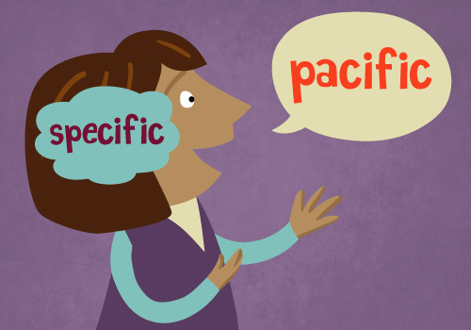
Phonological
awareness
The Phonological core deficit
Ability to mentally break words down into their smallest units of sound (phonemes), to hear these phonemes in isolation (discriminate), chop them off of words (isolate) and to manipulate them (move them around and blend them back together). These skills are a precursor to being able to read and spell with the alphabet.
Without specialist intervention, these difficulties hamstring decoding ability and decoding is the bedrock of fluent reading – the vast majority do not get specialist evidence-based intervention.
From here, the Matthew Effect kicks in…
This is why these kids’ reading ability would horrify you.

Slide 16
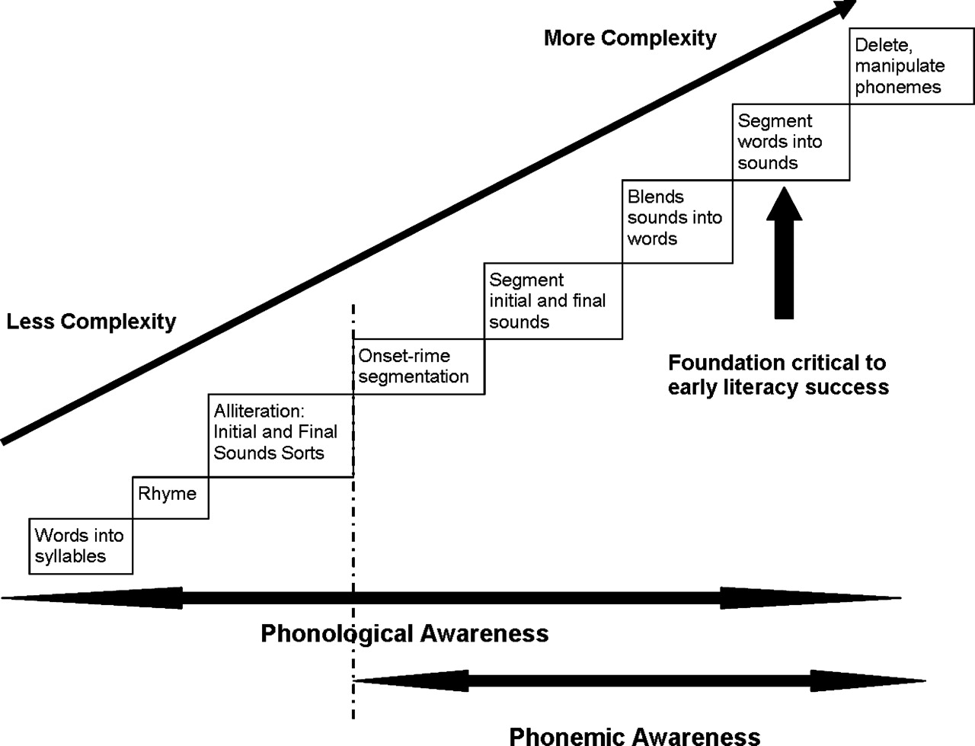
Phonological Awareness
Notes:
Daily Prep-3

Slide 17
Something to show the folks back at work…..
https://www.youtube.com/watch?v=PhwxWv_D_YU&t=873s

Slide 18
Rapid
Automatized
Naming
(RAN)
Slow Automatized Rapid Naming (RAN)
Refers to how quickly people can retrieve phonological information from long term memory (names of objects, pictures, colours, letters or numbers) and say their names aloud - RAN is a strong predictor of reading ability.
Of course – fast RAN of words, morphemes, syllables and letters is critical to fluent reading.
Many studies have shown that Rapid Naming is an area of weakness in many people with dyslexia.
Slow RAN will persist throughout life even if the phonological core deficit has been remediated so, reading will always be…..

Slide 19
Rapid Automatized Naming/Rapid Alternating Stimulus
Notes:
Sarah
RAN/Ras – objects, colours, letters , numbers and mixed.

Slide 20
RAN/RAS- Example of scoring
Notes:
Sarah

Slide 21
Auditory working
Memory
Working memory weakness
the ability we have to hold in mind and mentally manipulate information over short periods of time. Working memory like the mental workspace that we use to store important information in the course of our mental activities
There’s nothing that improves it other than understanding it and using strategies
Activities often require the child to hold in mind some information (for example, a sentence to be written down) while doing something that for them is mentally challenging (such as spelling the individual words in the sentence). These are the kinds of activities on which children with poor working memory struggle with most, and often fail to complete them properly because they have lost from working memory the crucial information needed to guide their actions.
Children with poor working memory also have problems following lengthy instructions to do one thing after another, because they forget the instruction before the whole sequence of actions has been completed.
Notes:
Bill

Slide 22
Hippopotomonstrosesquippedaliophobia
Fear of long words

Slide 23
Something to show the folks back at work…..
https://www.youtube.com/watch?v=YSz-okYyzxQ

Slide 24
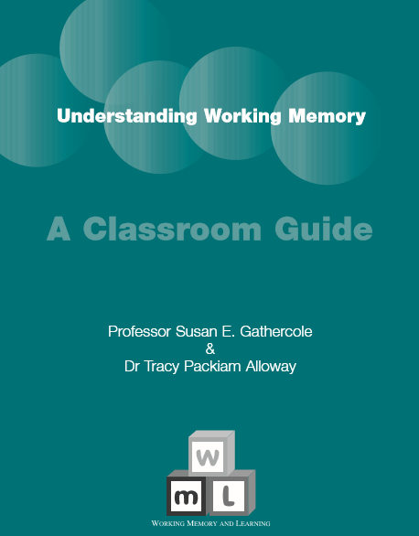
An understanding of working memory is fundamental to good teaching:
This is essential reading
Notes:
Sarah

Slide 25
Visual-
orthographic
processing
Poor Orthographic Processing
Ortho - straight
Graph - writing
The capacity to rapidly and accurately form images of the individual letters and spelling patterns of our language in memory. This includes letter form and orientation, common letter combinations and syllable types.
Does a word look right …smoke and smoak ?
Only a stable orthographic image of the word smoke will help as both are phonologically right
Orthographic processing weaknesses show up in spelling.
Notes:
Bill

Slide 26
This poster is for sale – see Bill
Spelling rules are lifesavers for folks with dyslexia
With time and practice they help to compensate for poor orthographic processing
Don’t be told otherwise

Slide 27
A glimpse into the agony
“Not a Cruel Fiction”
https://www.youtube.com/watch?v=rRdgip22h9I
“The imposter within”
Notes:
180

Slide 28
Definition, Your Task: groups of 4
9:18:00 AM
Take all three definitions and come up with
4 things you want us all to remember about dyslexia.
Plan to present these to us as creatively as you like:
Visually
Auditory
Kinaesthetically
You want to help it to stick in our memories, you have 10 minutes.
Notes:
20m (1200)
Need each definition printed x12
10 minutes to come up with a creative and novel way to have us remember your definition.

Slide 29
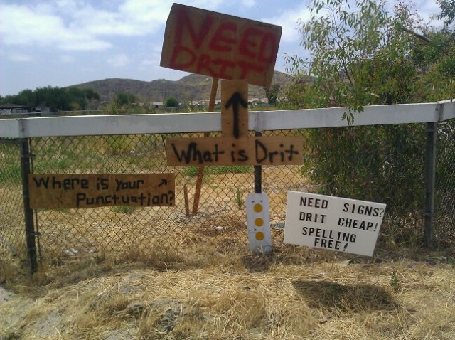

Slide 30
Environmental factor English most difficult language Seymour, 2003 in Gabreili
Easiest Languages
Italian
Icelandic
Norwegian
Spanish
German
Dutch
Finnish
Most difficult languages
English
Danish
French
Notes:
60sec
If God told you before you were born that you will have dyslexia, you’d plead with him to make you Italian!

Slide 31
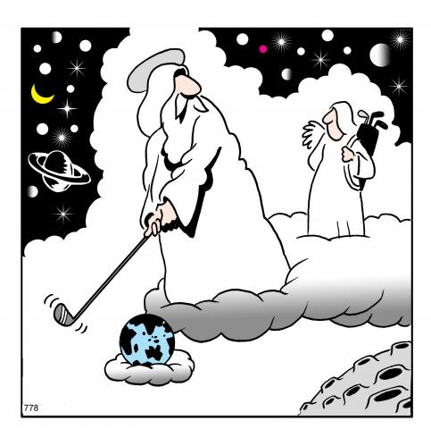
It’s time we toughened you up. In your next time on earth you will be born with dyslexia
OK Boss, I can live with that as long as I’m born in Italy, Iceland, Norway, Spain, Germany or Finland! If its an English speaking country, I’m calling the union!

Slide 32
Causes: Australian research (2010)
“…there is no single cause of developmental dyslexia and it is likely that multiple causes interact in complex ways to impair reading acquisition...”
Anne Castles, Gregor McLean and Genevieve McArthur
Macquarie Centre for Cognitive Science.
Dyslexia (neuropsychological) John Wiley & Sons Vol 1, May/June (2010)
Notes:
60sec

Slide 33
So: What is Phonological Awareness?
Pre-teaching of terms you’ll need
What’s a Phoneme?
What’s working memory?
What’s Irregular spelling?
What’s verbal memory?
What’s sound blending?
What are non-words?
http://www.youtube.com/watch?v=71a_uVEH_dw
The Phonological disorder (after Hatcher & Snowling)
Notes:
300sec
A strategy for dyslexic learners is to pre-teach unfamiliar words or terms that will be included in a new topic of work. It just gives them a head start on the words, particular the spelling of them, which may be a hurdle.

Slide 34
Testing Phonological Awareness
Phonological Awareness Screening Test– Kilpatrick (McInnes)
Sutherland Phonological Awareness Test (SPAT)
The list goes on and on….
Notes:
600sec
Let’s have a play with the Test for Teachers in ‘A Sound Way’ to get a handle on these skills.

Slide 35
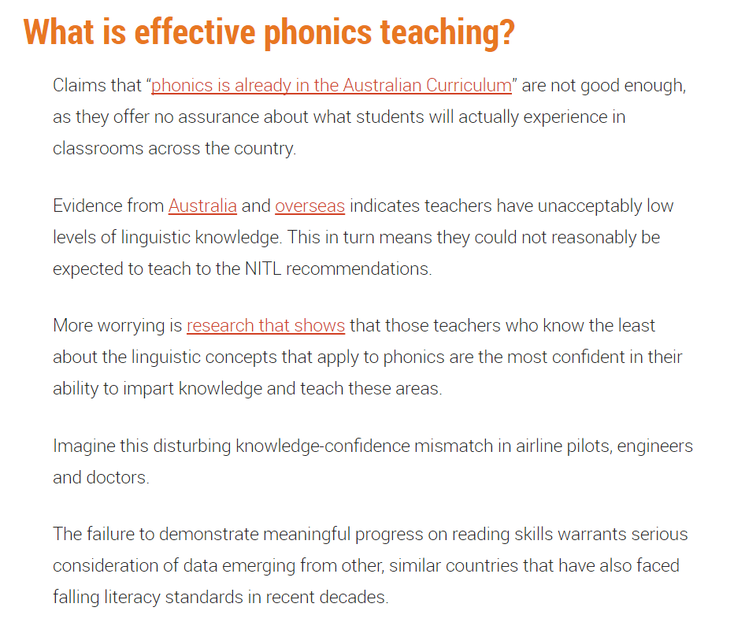

Slide 36
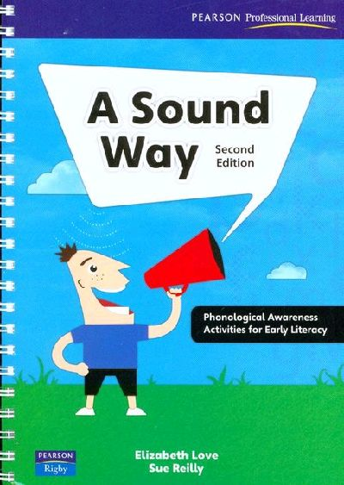
Testing Phonological Awareness
1.
3
3
4
4
3
2
3
3
5
3
2.
4
4
4
6
3
4
5
5
5
10
3.
‘r’
‘c’
‘w’
‘i’ (igloo)
‘or’
‘r’
4.
‘f’
‘f’
‘p’
‘o’ (as in toe)
‘uh’ (as in appear)
‘j’ (as in jam)
hasten / basin
pastie / nasty
some / numb
stuff / enough
cholera / quiet
pneumonia / knave
shoal / chauvinist /chef
joke / gentle
5.
6.
Notes:
600sec
Let’s have a play with the Test for Teachers in ‘A Sound Way’ to get a handle on these skills.

Slide 37
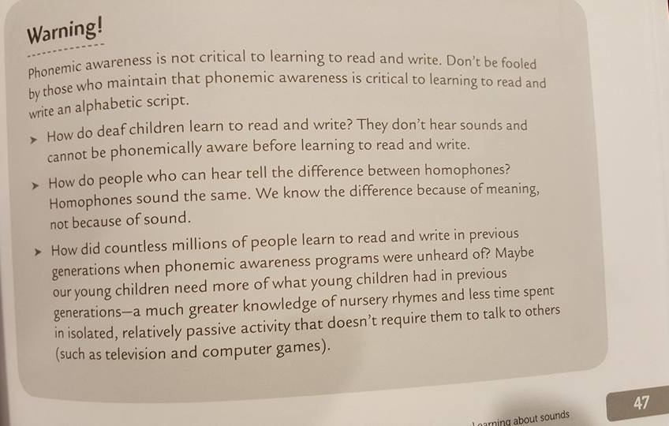
Are you kidding me?

Slide 38
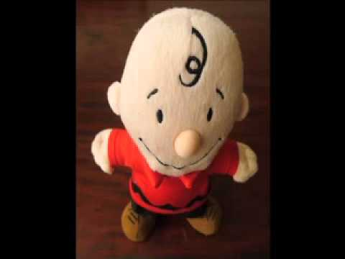
“How Phonics Got Framed”
https://www.youtube.com/watch?v=rRdgip22h9I

Slide 39
So what is Dyslexia?
10:00:00 AM
Notes:
240sec
Sparktop Video 3:50

Slide 40
Notes:
60sec
So to understand dyslexia let’s take a look inside the human brain
It’s like billions and billions of tiny electrical wires. The way these wires are connected decides what we are good at, how we behave, how we react to different things, how our body works and all sorts of other things that make us who we are.
Every time we learn something new these tiny wires make new connections. If we get enough sleep and practice what we have learned, these connections get stronger. Our brain is changing every day – making new connections, breaking old connections we don’t need any more.

Slide 41
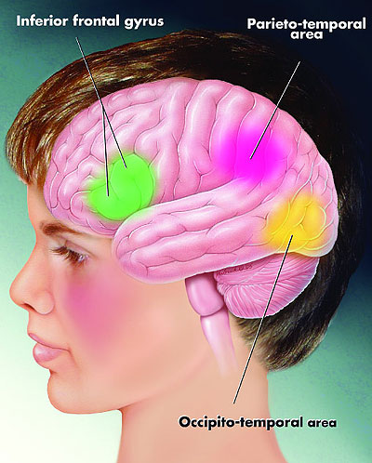
The parts of the brain that work together when we read really well and quickly
Notes:
60sec
These are the parts of the brain that all work together when we read.
What scientists are starting to think is that this difference in how the wires are connected makes learning to read, spell, write tough BUT at the same time gives many people with dyslexia AMAZING talents. Some people with dyslexia actually call their dyslexia a gift because it has made them so good at some things.

Slide 42
http://www.youtube.com/watch?v=3XQcdVp9sls
10:16:00 AM
Notes:
180

Slide 43
Spotting Dyslexia early
Notes:
60

Slide 44
Spotting Dyslexia early (Shaywitz)
Delay in speaking:
Words @ 1, phrases 18 @ months (dyslexia @ 15m / after 2nd birthday)
Difficulties in pronunciation: lasting past say 5 or 6
Leaving off beginning sounds (pisghetti for spaghetti)
Inverting sounds within a word (aminal for animal)
Anything to indicate problems hearing all of the sounds and lining them up in order in the speech stream
Poor sensitivity to rhyme
knowledge of nursery rhymes = predictor of reading success
3 and 4 year olds recite nursery rhymes accurately and play with rhyme
dyslexic kiddies struggle to remember them or tell you which words rhyme:
Do ‘food’ and ‘foam’ rhyme? What about ‘walk’ and ‘talk’? (can they break in?)
Use Sutherland for this or just play with rhyming pairs if worried
Notes:
60

Slide 45
Spotting Dyslexia early (Shaywitz)
Pulls up the wrong sound
Looks at picture of volcano and says ‘tornado’ – close in sound, not in meaning – but knows the correct one given the choice : but on the spot…
Retrieval issue causes them to ‘talk around’ the word they’re looking for (circumlocution)
Language becomes non-specific ‘things, stuff, them, it, that…’
Kids that we know are intelligent look inarticulate…frustrating right?
Trouble learning the names and sounds of the alphabet
Trouble seeing that words come apart into syllables and sounds
Trouble matching letters to sounds
Reading errors that show no connection of sounds to letters (big for goat)
Trouble with one-syllable (CVC) words: mat, cap, not, hat…
Getting out of there!
Family history of reading difficulty: ask parents how they and their siblings enjoyed school! Brothers, sisters?
Notes:
60

Slide 46
Spotting Dyslexia early
⇨ Reads slowly and has difficulty blending the sounds in words
⇨ Difficulty pronouncing multi-syllabic words
⇨ Spells the same word in a variety of ways
⇨ Difficulty learning times tables
⇨ Poor sequencing skills, resulting in errors in reading or writing letters (b/d), numbers (12/21) and/or
words (was/saw).
⇨ Inconsistency in learning, e.g., is a good thinker but has problems in getting ideas onto paper
⇨ Difficulty in remembering a list of instructions
⇨ Has little to show for the effort put into their work
⇨ Concentration may seem poor
⇨ Difficulty with organization of work
⇨ Problems copying accurately from the board
⇨ More difficulty than peers in learning letters and sounds
Notes:
60

Slide 47
Spotting Dyslexia early (Shaywitz)
In addition to problems with speaking
and reading, look for:
Curiosity
A great imagination
Great at figuring things out
Great in class conversation or circle time
Eager embrace of new ideas
Gets the gist of things – sees the bigger picture
A good understanding of new concepts
Surprising maturity
Large vocabulary for age group – especially when relaxed
Loves puzzles
Builds models well
Excellent comprehension of stories told or read to him – sometimes almost freakish inferential comprehension
Notes:
60

Slide 48
So, how would we like to make that stick?
Circle up and pair share & feedback
Whole Group go-around
Privately highlight the important points on handout?
Notes:
600

Slide 49
10:34:00 AM
You may be dyslexic if…
http://www.youtube.com/watch?v=5qvqG9z0PZo
Notes:
180 sec

Slide 50
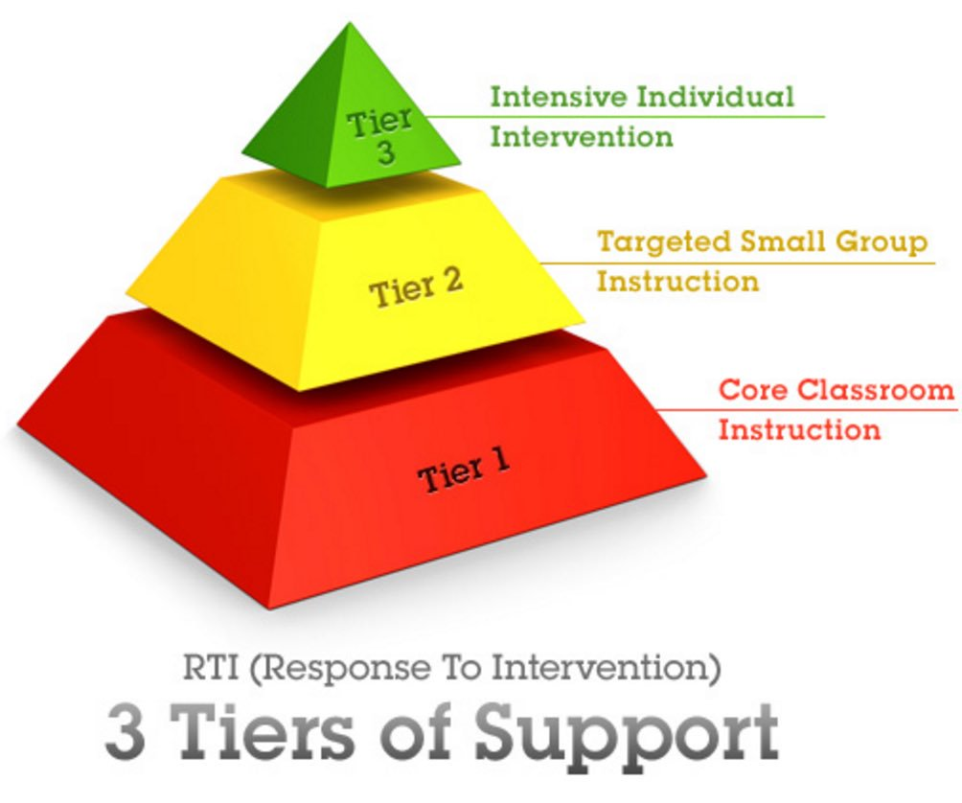

Slide 51
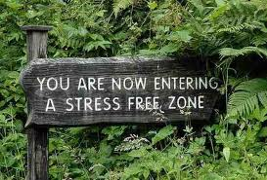
What Can I do in the classroom?
10:47:00 AM
Take the pressure off yourself your job is not to remediate their dyslexia, you simply cannot as a classroom teacher.
Your job is to understand their difficulties, demonstrate unwavering faith and help them around their difficulties.
Notes:
180

Slide 52
What Can I do in the classroom?
Understand
The best classroom instruction will make life easier but will not remediate dyslexia
They will forget, and forget, and forget
They may be disorganized
Seat them well
See, hear, ask the teacher
Next to helpful others who can repeat instructions, re-read for them, help keep them organised
Move them but keep them within support group
Notes:
60

Slide 53
What Can I do in the classroom?
Remove distractions, eliminate ‘cruise’
As hard as it is, keep distractions to a minimum
Have spares of everything (pencils, rulers, books close to reduce their movement around room
Laminate a list of what they need to keep in their pencil case and rubber band it to the zip. Get them to replenish pencil case each morning from the ‘extra stocks’
Can their tray be within reach of their seat?
Notes:
60

Slide 54
What Can I do in the classroom?
Speak slow, speak short, use pause!
Plan in your head before giving instructions (or stand back and watch them glaze!)
Remember ‘sea of blah’
Write what you’ve just said
On board
In book
On sticky note
Carry a highlighter with you at all times
Mob phone pic
Notes:
60

Slide 55
What Can I do in the classroom?
Encourage questions
Ask “what didn’t I explain well enough?”
Remember listening memory is impaired
Get them to repeat back instructions
Write instructions on board (hush and point)
Get the whole class to repeat instructions to each other http://www.youtube.com/watch?v=XroJtR9gQc8
Notes:
60

Slide 56
What Can I do in the classroom?
10:54:00 AM
Write Clearly
Large, neat print
New line, new colour
12pt or above, comic sans or sassoon
Corrections in book legible
Circle, underline or highlight only incorrect part of word
Notes:
60

Slide 57
What Can I do in the classroom?
Don’t make them try to remember - it’s madness
Table charts, calculators, tape recorders, word processors, cameras…
Remind them that it’s not cheating – over and over – getting these kids to use accommodations in secondary school is very hard because of the garbage that some of us teachers have filled their head with about needing to listen and remember.
Break work into small bits – give projects 1 part at a time
Test orally / assess differently
“Doesn’t my history teacher get it? If he wants me to write essays all the time then all his testing is my learning disability, and I’ll just keep showing him I’ve got a really bad one”

Slide 58
What Can I do in the classroom?
Expect to have to tell them again...................
Dyslexia is a working memory disability
Poor organization comes with the disability
it’s NOT laziness, NOT a moral failing
Try not to criticize, ask them what will help
Put together a basic survival kit
pen, pencil, rubber, ruler, dictionary, tables chart, calculator, diary, etc.

Slide 59
What Can I do in the classroom?
Appreciate that writing is hard
Spelling won’t pick up as reading does
Copying from board – try to avoid it (Laura’s algebra notes)
Give them photocopied notes and a highlighter or let them copy notes – as simple as photocopying or printing your notes – do it for everyone!
Allow time
Give them less work
Mark written work considerately
Mark for ideas, don’t sweat the spelling or handwriting too much!
Notes:
60

Slide 60
What Can I do in the classroom?
Never...ever make them read aloud in front of the class...ever
Notes:
60

Slide 61
Meet Tim…
Notes:
Meet Tim
You’ve probably guessed. Tim did grow up, and it hasn’t been without its struggles.
He’s 15 year old now. Here he is…

