Slide 1
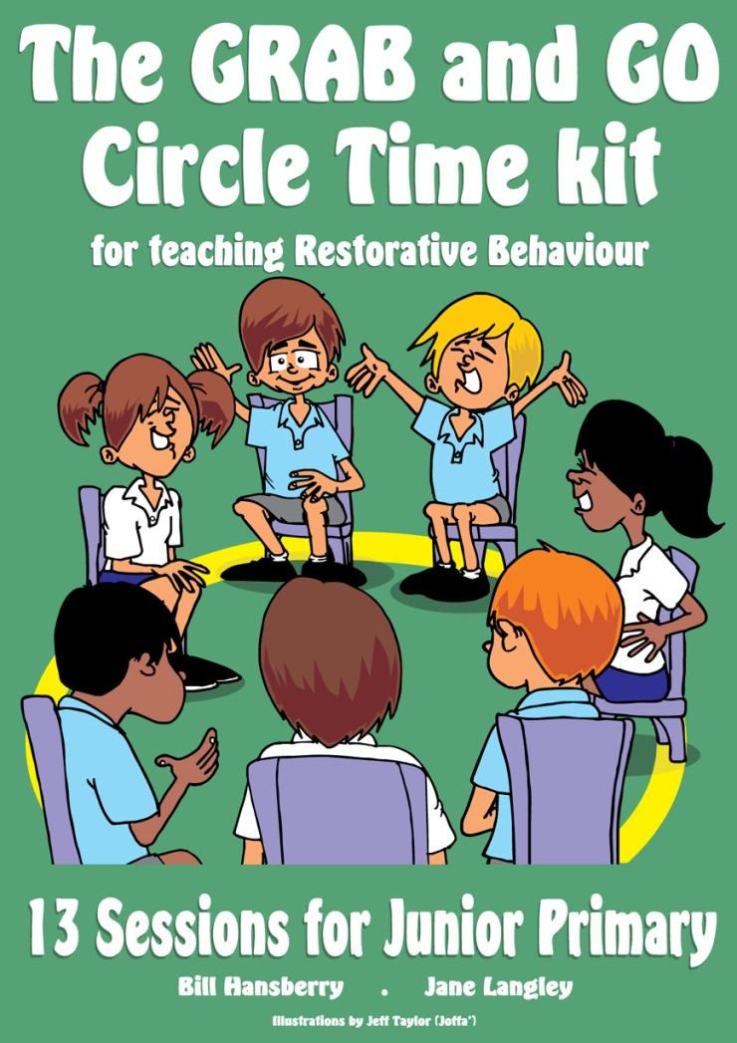

Explicitly Teaching Restorative Thinking and Behaviour to
Students
Bill Hansberry

Slide 2
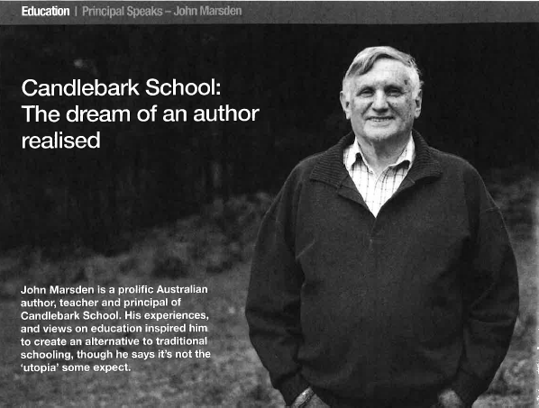
School: It’s no utopia
...our problems…include parents who think that school is utopian and are shocked if their child is insulted or hit... (I would like to tell prospective parents)...Whilst your child is at school there is every likelihood that he or she will be bitten, kicked, hit, sworn at, abused and insulted (and that’s just by the teachers). Just joking. This will happen because we are a community of normal people, and normal life includes moments of friction, anger, tension, jealousy...It's likely that your child will bite someone, kick someone, hit someone (etc.) at some stage too. We do not provide a magical oasis of beauty and peace. We do provide an environment where people can learn to cope with the vicissitudes of life. Every relationship has some ugly moments and some difficult aspects. It's never too early to develop an understanding of that and acquire strategies to keep moving forwards.
John Marsden, Author and Principal of Candlebark School, School News, Term 3 2016 pp 10-11
Notes:
I have no idea if Candlebark is a Restorative School
But, John Marsden certainly has the right attitude about life and politics
This stuff is no for the faint hearted…never has been…never will be.

Slide 3
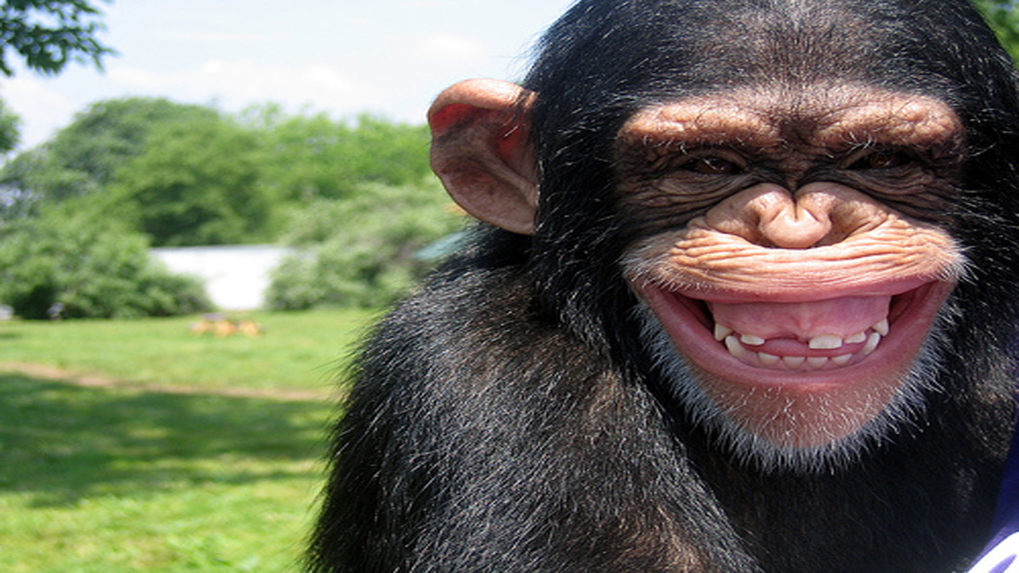
It’s not rocket science...It’s connection, connection, connection.
William Pollack PhD
Having fun and laughing together promotes a sense of connection and raises levels of oxytocin - the ‘feel good’ neurotransmitter. Predominantly positive emotions foster creativity and problem-solving - they enhance people’s ability to think. They also help undo the effects of negative emotion - people bounce back more quickly from adversity (Frederickson, 2009).
Notes:
Opening Circle Games:
Pass the name / High 5
Name go around (Jumping Jane, Burping Bill)
Bill:
We all feel a bit more connected to one another now after having some fun and a laugh. We’ve just experienced affective resonance. We smiled and laughed together and the positive emotions we experienced were broadcast and caught be others! We know intuitively that’s how Circles work to create a sense of belonging and community.
Read Fredrickson Quote from slide.
Vick Kelly will talk more about this on Thursday if you are attending his post conference workshop.
Circle Time Rules – getting consensus on rules
Do Silent statements –manual p24 (top)
Bill:
In circle time it’s sometimes tricky to think about being fair to others when we are excited! Side conversations easily happen; people can talk when it isn’t their turn or giggles can sometimes get a bit loud and go for a bit long. You think I’m talking about children don’t you??
It’s actually beautiful to watch staff groups giggle; crack jokes and connect in ways school life doesn’t usually allow. They have such fun, BUT – we always ask them to think about how easy it is to lose a bit of control and to reflect forward to this happening when it’s them facilitating circle time with a group of children whose engines are far bigger than their brakes (point to frontal lobe).
Circle Time has already done the trick with this group. Our brains have released chemicals that have dampened our amygdala, so we no longer see each other as potential threats and we are engaged in the positive affects of interest and enjoyment with one another.
We’d better introduce ourselves:
Jane:
Bill:
Hi, I’m Bill...I’m married to Christie (not Jane – but you may see us acting like an old married couple today as I stuff things up and she reminds me what I should be doing) I’m father of two boys and a girl– Lawson 11, Millah, 9 and Judd 6. I’m a teacher by profession and have worked in a range of roles over my time in schools.
I’m now completely my own boss and as an external consultant in schools and in private practice at Fullarton House in Adelaide with children and adolescents I affectionately refer to as the Tricky Kids; the kids whose lives are compromised by the unpredictability of their functioning, or by the capricious nature of their home life, or by both. Consequently, they find life much trickier than most and in the process make life trickier for those who care for them educate them, share classrooms with them. I am truly privileged to spend most of my days with these kids, their parents and often their teachers.
In between times I enjoy presenting at conferences throughout Australia. Besides Christie and my kids, one of my greatest loves is writing. I’ve been involved in the writing of three books on working restoratively and relationally in schools, one of those, one as a contributor, one of those – my own book. I have a few projects in the line, one, a parenting book called ‘Raising Beaut Kids – Recipes for Parents on when to say yes and how to say no” that I’m co-writing with Mark LeMessurier.
My favourite is the one we’ll work from today - the labour of love that Jane and I chiselled away at for the best part of four years. It’s my favourite because of the person who wrote it with me. Although she’d never admit it, Jane’s a dream to write with and has taught me a great deal about restorative practices with littlies. Her visual script is evidence of how Jane just gets how younger minds tick and I see it up in classrooms and counsellor’s office walls where ever I go.

Slide 4

skills kids need to
work restoratively...
Notes:
Jane:
What skills do kids need to work restoratively sticky note activity - list and order (Jane)
participants write 5 skills kids need to work restoratively on 5 different sticky notes
Make a list of the type of skills listed
Ask group to think about a child they know and think about how strongly they have this skills embedded
Place sticky
Ask/Brainstorm How do kids learn restorative skills? Modelled, explicitly taught, etc..
Give learning to play football visual diagram (I’ll explain later)
notes on a continuum from not yet embedded – embedded.

Slide 5
To work restoratively children need to be able to..
Calm themselves and listen to others
Use flexible thinking – reasoning skills
Empathise with others
Forgive themselves for indiscretions so shame can do its job
Move beyond ‘victim’ status
Recount a situation / Reflect on their part
Understand how their behaviour affects others
Name and understand their emotions
Work with others
Make collaborative decisions
Be objective – view their actions from ‘outside’
INABILITY TO DEAL WITH SHAME

Slide 6

Restorative thinking and behaviour require explicit teaching and Circle Time is the perfect forum for doing this.
Notes:
If the purpose of Restorative Practice is to restore relationships in the wake of wrongdoing or conflict, then the role of Circle Time is to help build the relationships children consider worth restoring. Circle Time is a practical way to skill young, developing human beings to listen with understanding, tune into feelings, share opinions and begin to see the world from another’s viewpoint. These are the very skills children need to function successfully in any social setting

Slide 7
The RP Pyramid
Restoring
Relationships
Managing Difficulties
and Disruptions
Developing Relationships
Developing Social & Emotional Capacity

Slide 8

Swap seats
Notes:
Jane: silent statements:
those just starting with RP’s at their school
For those looking to teach restorative thinking to younger students
Bill: Wrestling ring introductions (refer to slide)

Slide 9
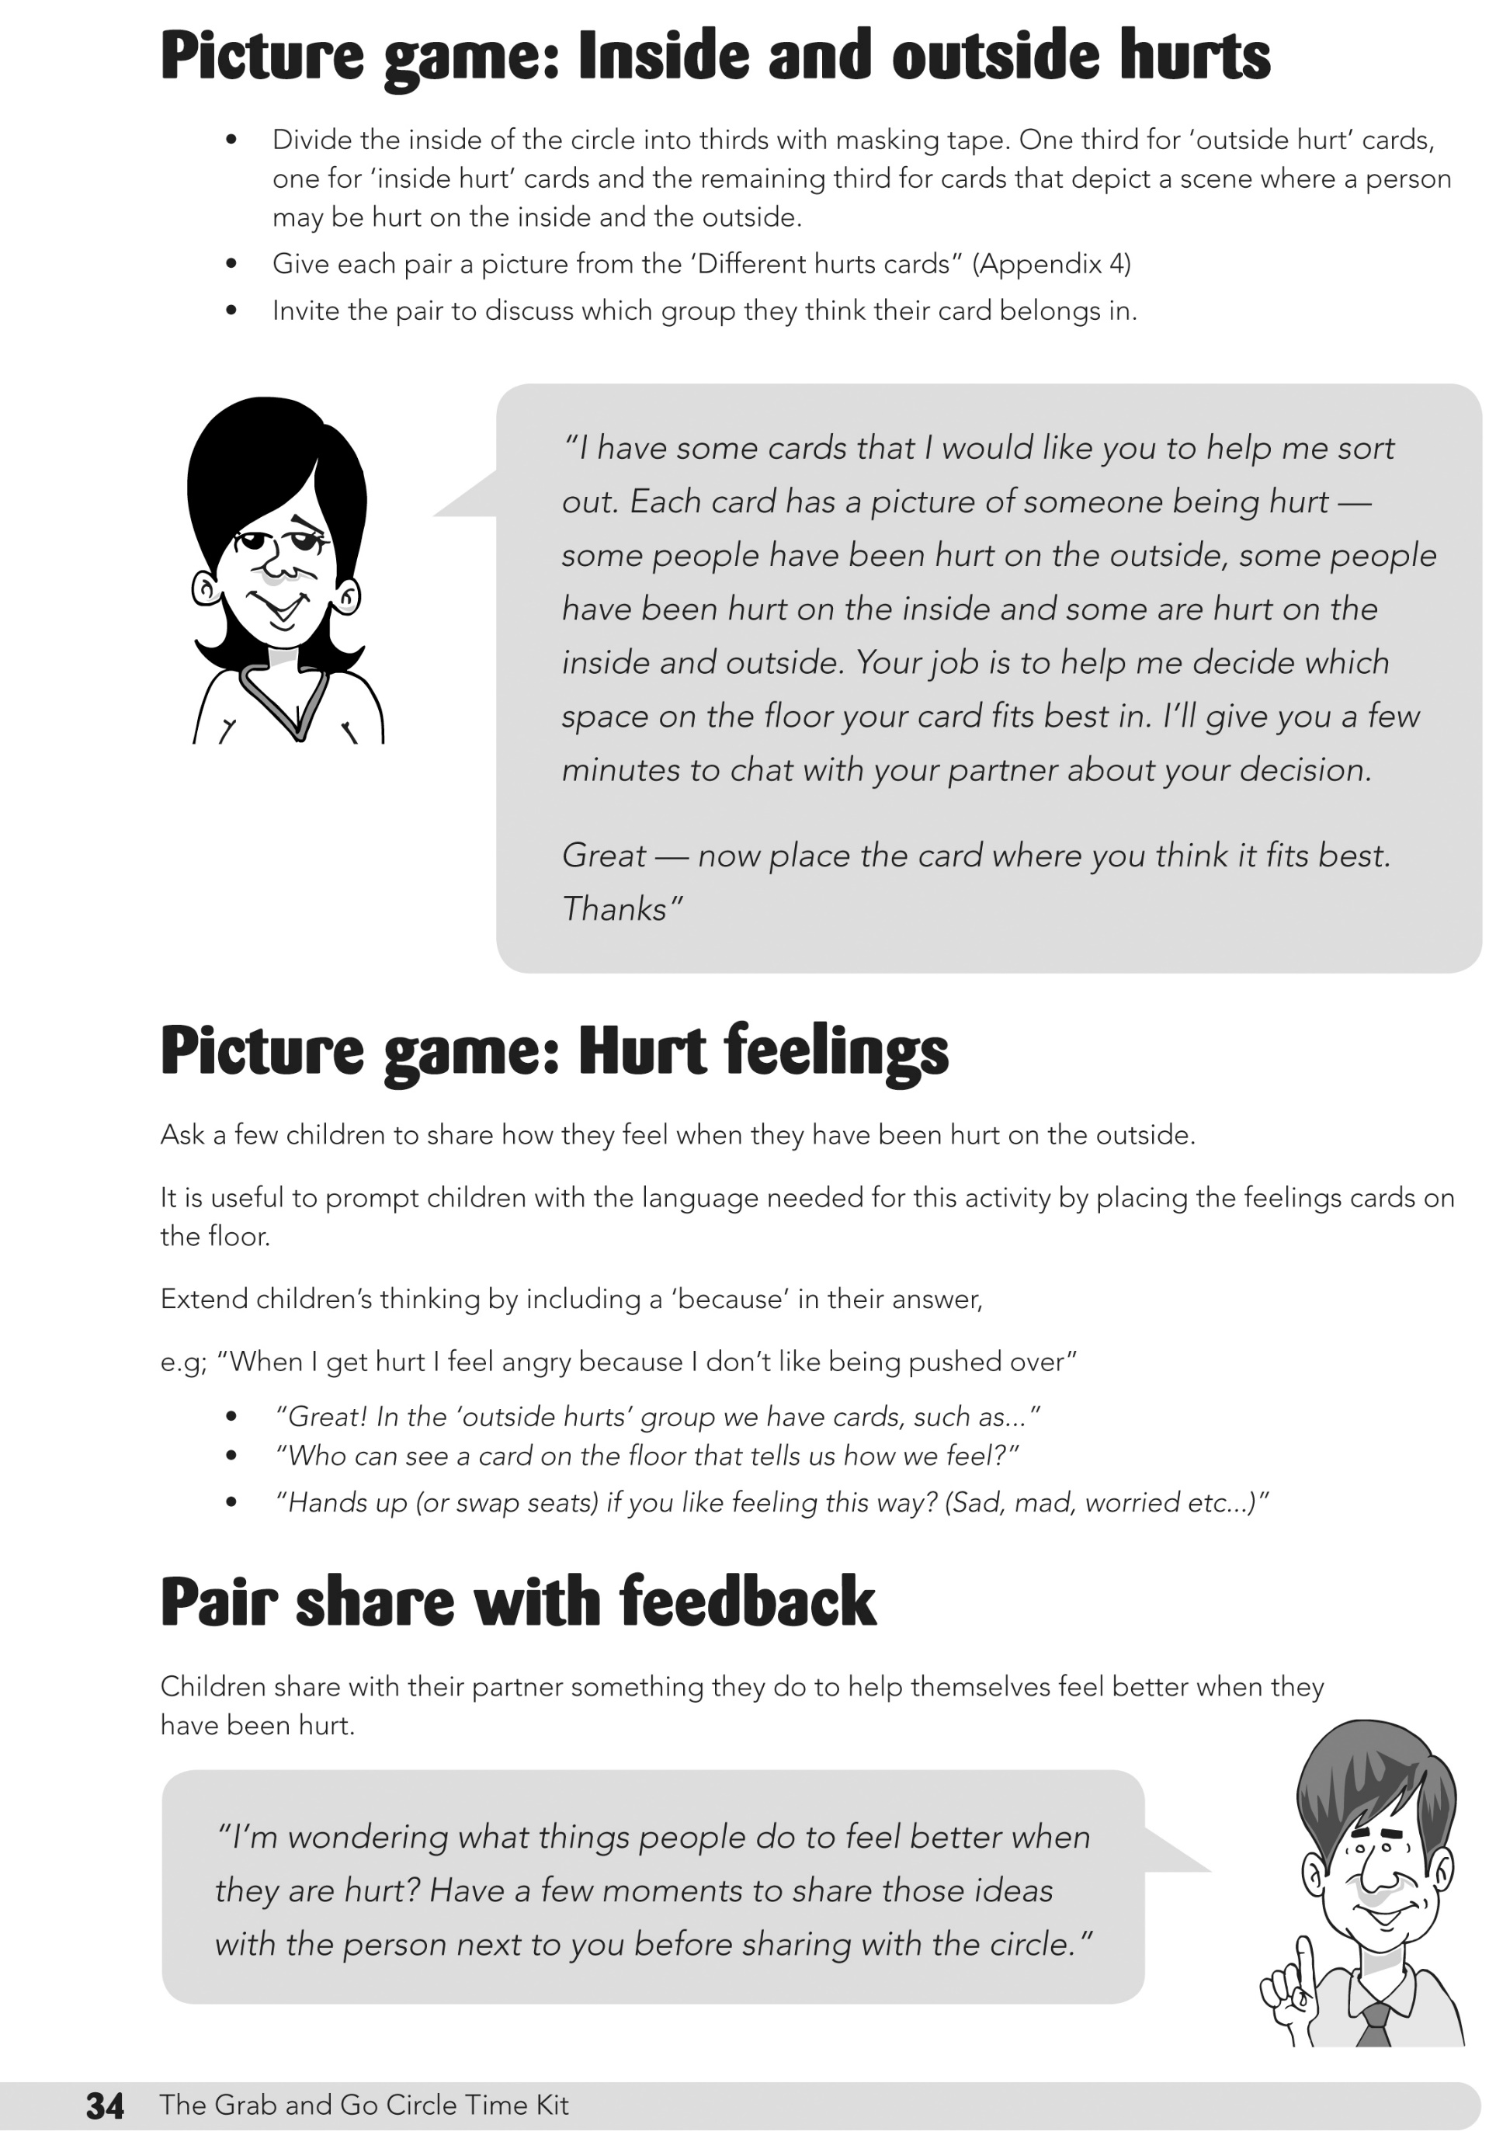
From session 2 Inside and Outside Hurts
Notes:
Jane:
Explain why this is an important concept for kids – take from introduction to session in the manual:
People can be hurt on the outside (physically), on the inside (emotionally) and sometimes both. Children benefit from the chance to safely share stories of their own hurts and practise distinguishing between different types of hurts as well as considering the different emotions triggered by hurts.
Sorting task p34 – in small groups sort pictures into inside and outside hurts

Slide 10
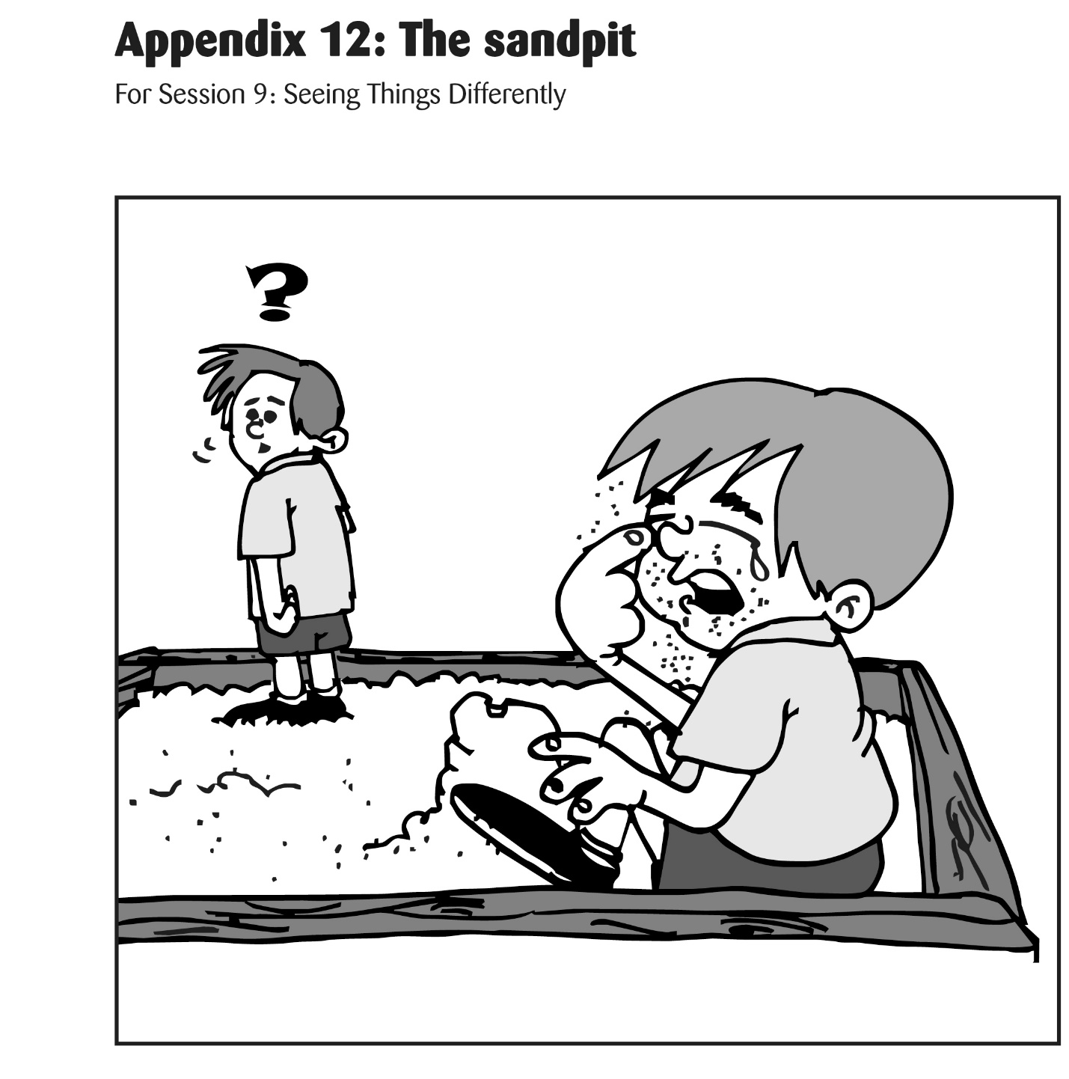
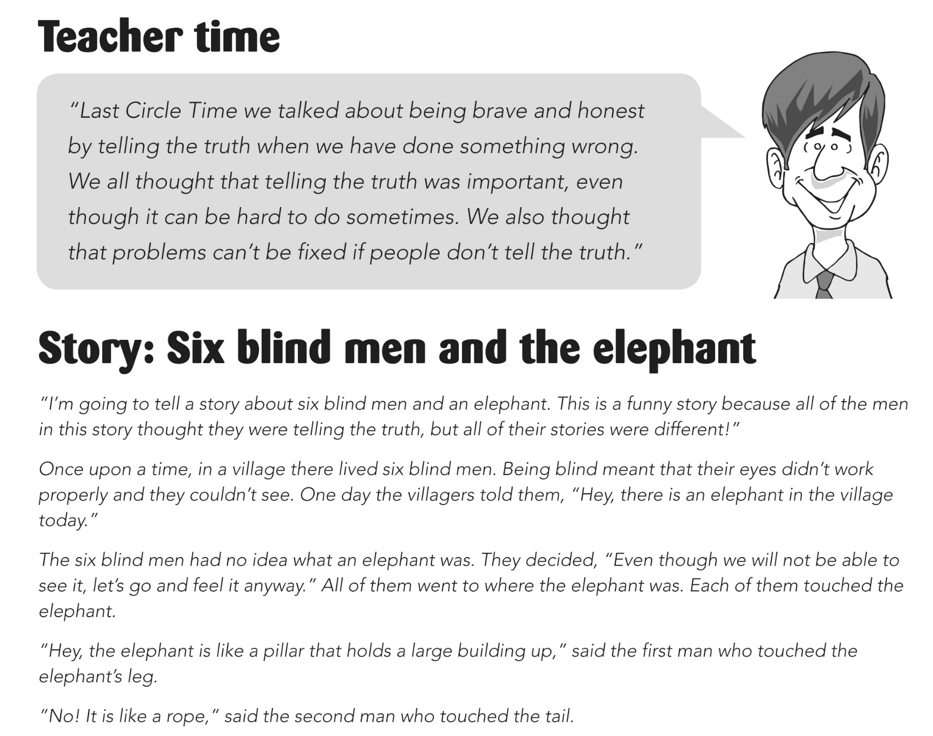
From session 9 Seeing Things Differently
Notes:
Some kids with different processing or those suffering trauma can be on high alert and often perceive accidents as intentional hurts. This leads to quick fire reactions and deeper issues. Much of our restorative work in schools is about helping these kids come to understandings about the intention of incidents as well as helping them understand that two people can see the same thing happen and attach entirely different meanings to them.
Session 3: Accidental and Intentional Hurts and Session 9: Seeing Things Differently are aimed at themes of intent and perception. They draw on a story of two boys in a sandpit and the classic fable: the six blind men and the elephant. We just can’t talk about perception enough with kids.

Slide 11
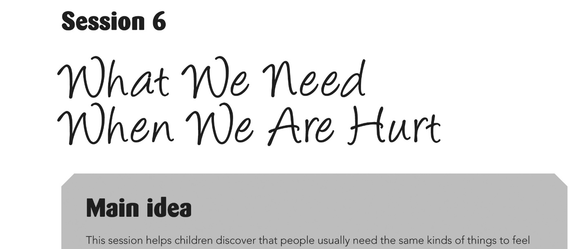
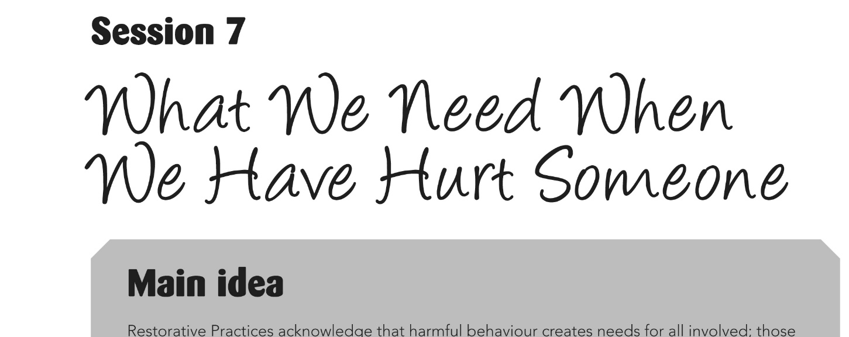
From sessions 6 & 7
We’ll do this today as it’s a powerful theme for older kids
What do we know as Restorative practitioners about meeting the needs of those in an incident of conflict or harm?
Notes:
Bill:
The wonderful Peta Blood takes groups through a powerful exercise in her trainings where participants are carefully led to understand that people have similar needs when they are harmed, or when they have harmed others. This strikes at the heart of the restorative principle of offering processes that simultaneously support those harmed and those responsible for harm.
This inspired us to create two sessions to address these two important ideas. We live in a world quick to condemn those who make mistakes and quick to forget those who fall victim to these mistakes, so it’s important to build kids’ awareness that needs are created on both sides when something goes wrong between people.
Divide circle in half – needs when hurt, needs when harmed other – groups feed this back, we record on whiteboard – what do you notice (Jane)
Reference the sessions in the book that deal with this (session 6 and 7)
CLICK
Jane:
What do we know as RP practitioners about what we need to do to meet the needs of those in an incident? We need to facilitate a conversation (WARM)

Slide 12
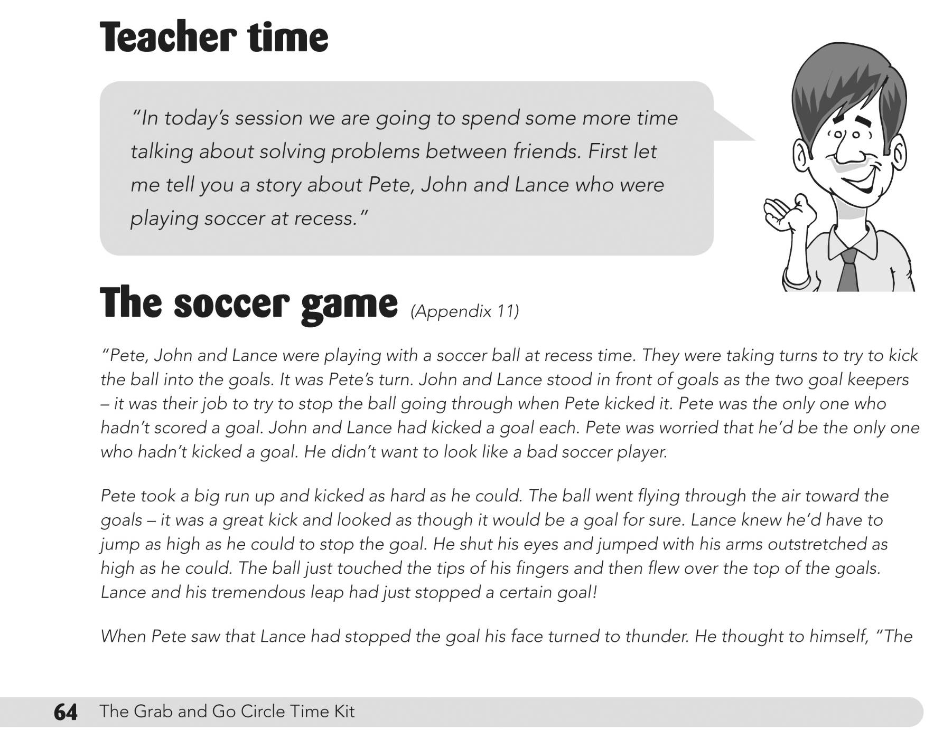
From session 6 What we need when we are hurt
Notes:
Bill:
Tell the soccer story (Bill make big book)
Give all a piece of the pictures from page 136-137 (in quarters) to from groups of 4 (Jane)
Once in new groups – give them the fixing questions for Pete and Lance – they do the sorting like in page 103 (Bill and Jane)
Discuss thoughts on the questions used - Separate questions into WARM (Jane)
Good practitioners adapt the skeleton script but adapt for the needs of the group (Jane)
Quick reference to EY script – give them a EY card

Slide 13
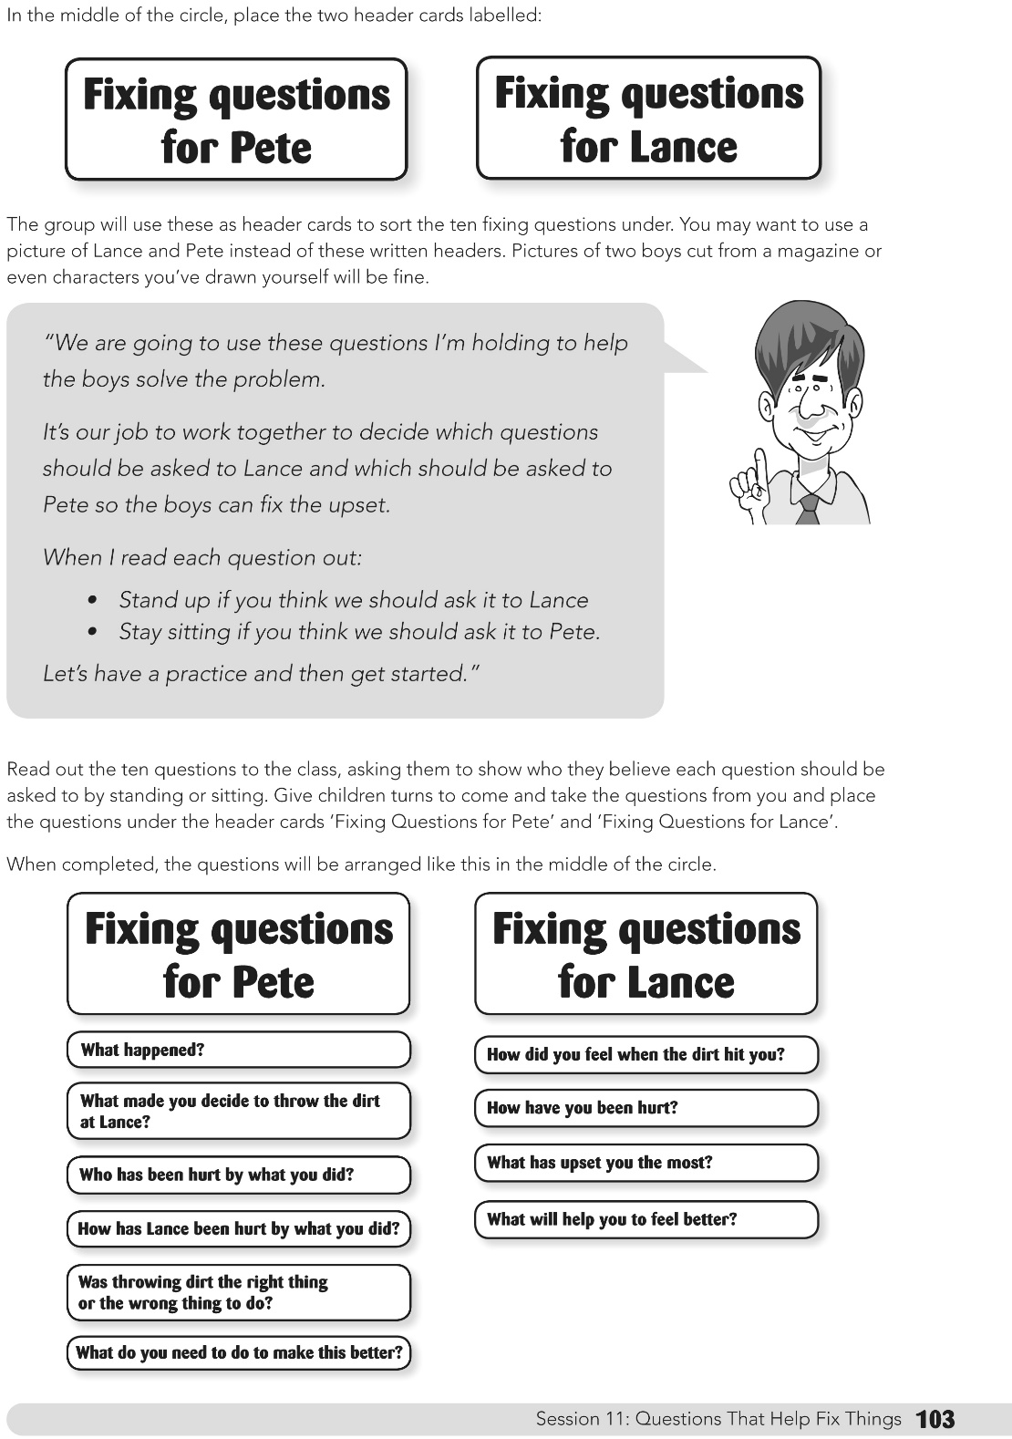
From session 11 Questions That Help Fix Things
Notes:
Bill & Jane
Once in new groups – give them the fixing questions for Pete and Lance – they do the sorting like in page 103 (Bill and Jane)
Discuss thoughts on the questions used
Jane
Separate questions into WARM
Good practitioners adapt the skeleton script but adapt for the needs of the group
Quick reference to EY script – give them an EY card

Slide 14
The Purpose of Sorry
An apology is a statement that ideally expresses regret over an action
We apologise …..
  When we realise something we said or did was wrong
  To fix things up
  To repair relationships
  To move on
  For our own need to remove guilt and shame
Apologies give us the capacity to make a new start

Slide 15
Building an Apology
The first sentence should describe what was said or done that was wrong.
The second sentence explains why it was wrong (how it affected you / school rule)
The third sentence states what choice should have been made or will be made next time.
“I'm sorry for hitting you, I know it hurt you, I should have used my words.”

Slide 16
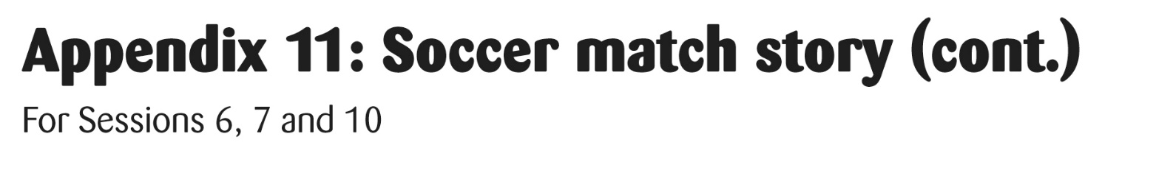

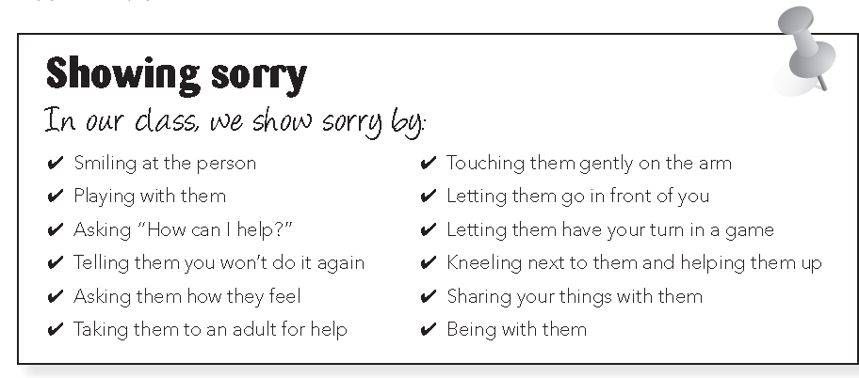
    Pair Share and Feedback
    How will Peter show Lance that he’s sorry tomorrow?
    one idea from each pair

Slide 17
The Reply
“Thankyou for your apology
I didn’t like it when you
snatched my truck.
I felt sad.”

Slide 18

    Pair Share and Feedback
    How will Peter show Lance that he’s sorry tomorrow?
    one idea from each pair

Slide 19
Ideally our aim is to move young people along the continuum
Unconsciously Incompetent
Consciously Incompetent
Consciously Competent
Unconsciously Competent
From Unconsciously Incompetent
To Unconsciously Competent

Slide 20
Questions

