Slide 1
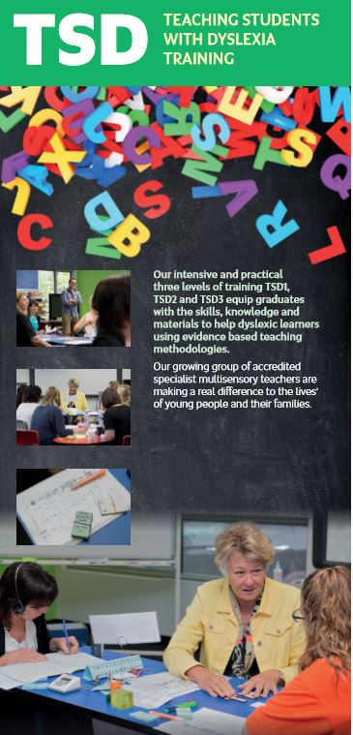
TEACH
THEM ALL
AS IF THEY WERE
DYSLEXIC
AND YOU TEACH
THEM ALL
BETTER!

Slide 2
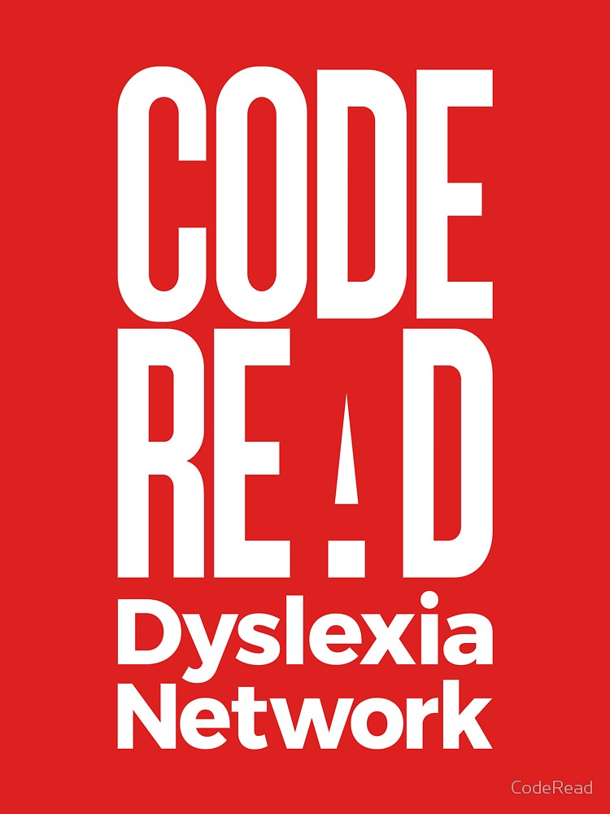
Notes:
I’m just so encouraged by what I see happening in South Australian schools right now. We are on the cusp of a long overdue revolution about how we teach reading and literacy in schools.
In my opinion, this is largely thanks to a bunch of fed up parents of children with dyslexia (mostly mums), who a few years back decided to organise and very quickly created networks across Australia. Dr Sandra Marshall, a local GP was instrumental in this. Sandra is currently the tireless (overworked and unpaid) president of code red – the national advocacy body that this movement has grown into.
Now, the word is spreading far and wide. In SA, we have this incredible group called the Literacy Guarantee Unit, who have put today on and are working hard with brilliant educators to get the reading research into classrooms so we can all finally say goodbye to the ideologically driven whole language garbage which we can thank for Australia’s gob smacking underperformance on international measures of literacy.
I’ve not met a teacher who doesn’t want to teach more effectively but I’ve met plenty, like me, who were poorly trained pre service teacher education and left university knowing very little about how kids learn to read and spell and are expected from the get go, to teach and assess reading and spelling in a way that has no support in the research.
This is changing, and it is exciting to be part of it!

Slide 3
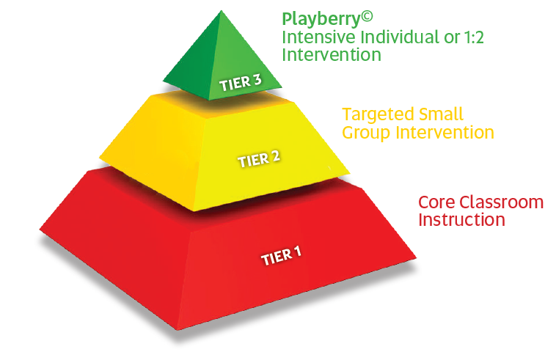
Response to Intervention (RTI)
Notes:
This is the Response to Intervention model –its IMPORTANT because I’ll be talking about it a lot today.
It’s divided into three bits. The fancy terms for these bits ‘waves’ or ‘tiers’ and even though I’m going to try to use the term ‘wave’ today, I’m bound to sometimes call them ‘tiers’ – lucky for us, they mean the same thing!
So what is this,
Well, essentially, its showing us that that if we teach reading, spelling (and more broadly, literacy) to the evidence, to all students in their normal classrooms, then fewer will need a small group withdrawal intervention (at wave 2) and even fewer than that will need intensive, 1:1, or 1:2 intervention at wave 3.
This model assumes a few things though.
That no matter how well you teach literacy in the classroom at wave 1, there will be some students who will need targeted intervention in small groups (at wave 2) and a smaller group who will have disorders of phonology (like dyslexia), or other disorders that are so severe, to progress, they will need a 1:1 or 1:2 at wave 3.
That withdrawal intervention is absolutely necessary if a school is serious about remediating low literacy learners – students are not remediated in classrooms. At best they are kept from drowning by being held up, but they do not learn to swim.
That if there is withdrawal wave 2 and 3 intervention, those teaching it are specially trained in disorders of reading (like dyslexia) and have expertise that goes beyond their colleagues who teach in classrooms AND….
That the instruction at all three waves is based in the science of reading and are using assessments that measure the right things.
If you are a school administrator looking at this and thinking ‘I can’t afford this’, my response is look carefully at where you are spending your money and find me something more important than kids leaving your school literate. Also know that there are a growing number of schools affording this with no additional funding. You’ll hear from some of them later today.
However, all of these schools will tell you, that when they first started their unconformable shift from whole language based ideological cack to three tiers of structured, synthetic phonics, underpinned by phonological awareness training across the school, taught directly explicitly in a multisensory way……. They’ll tell you that their pyramid did not look like this….
That it looked top heavy – sometimes more than half the cohort needing some form of intervention, especially around year 4 when the guessing readers were found out by the more complex words they had to read and they realised they had a problem of decoding due to whole language teaching in reception through to year 3.
These schools are now seeing fewer and fewer kids needing the specialist intervention and finally, with the pyramid looking more like a pyramid should, wave 2 and three are there for the kids with the more stubborn disorders of language and phonology.

Slide 4
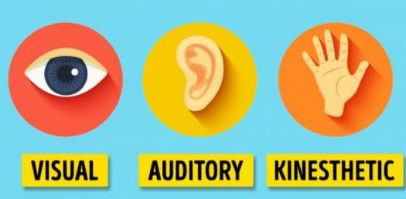
9:11:12 AM
Wave 1
All students
all classrooms
Wave 3
Intensive Multisensory Intervention
Alphabet work
Phonological Awareness
Alphabet work
Phonological Awareness
Phonics review
to structure
Grapheme
Phoneme
Phonics Drills
to structure
Grapheme
Phoneme
Multisensory
All that differs between waves:
Pace of instruction due to the volume of revision needed to get content overlearned
Demandingness of the diagnostic teaching which impacts…
adult to student ratio
Concepts review
to structure
Concept Drill
to structure
Grammar, spelling rules, morphology
Explicit Direct Instruction
Activate prior learning
Activate prior learning
Grammar, spelling rules, morphology
Revision
to structure
Fine grained, diagnostic teaching
Revision task
to structure
New Teaching
to structure
New Teaching
to structure
Game
to structure
Notes:
So when I was asked to do this talk, My goal was to demonstrate to you that what we, and the way we teach it at any of these three waves doesn’t differ greatly. Here’s my scribblings that I put to the LGU team. Wave 3 on the right – my typical one hour lesson sequence starting with Alphabet or Phonological awareness work and moving through phonics drills, revision of previously covered content, the teaching of the next thing (in line with the structure I use – Playberry) and then a game to consolidate previous learning.
CLICK (wave 3)
I work in my practice at wave three. I work with kids with dyslexia. Some relatively mild, some pretty severe. Today you’ll see me teaching these students.
CLICK (wave 3)
I’m also going to show you footage from some local schools of wave 1 classroom teaching.
Start CLICKING to build up the slide
I want to show you that regardless of whether it’s students in wave 3 - 1:1 or 1:2, or in a small group wave 2 setting (which I have some footage of), or in a classroom at wave 1, what we teach and the methods we use are pretty much the same.
Its all to a tightly controlled, fine grained sequence and puts a onus on educators to know what they’re doing and why they’re doing it.
It involves work on the fundamentals of learning the alphabet (you’d be staggered how many kids can rattle off the alphabet but can’t fluently match letters to their names)
And phonological awareness – the bedrock of permanent word storage AND…AND… The core weakness in students with DYSLEXIA.
It involves plenty of revision (built in retrieval of previously learned content) – some of this is through retrieval drills using flash cards
It involves the carefully planned (sometimes scripted) introduction of the next teaching point in the sequence we are teaching to, WHICH IS delivered explicitly and directly, with students’ cognitive load in mind (so to not cognitively overload kids, distractions are minimised, kids are seated so they can see the teacher and extraneous noise is controlled).
Makes you think twice about fancy open spaced learning areas where we have 60+ kids all doing different stuff doesn’t it! But I won’t bore you with the research on that!
ALL THAT DIFFERS between waves is pace of instruction and the numbers of students the educator has to watch and teach. Students with disorders of phonology like dyslexia need many more exposures to and much more practice with the content. They need it more often and more intensively. They need to be watched more closely so the pace of instruction can be altered if need be.
The diagnostic teaching (which is watching for what’s sticking and what isn’t as we teach and adjusting accordingly as we go) has to be a whole lot more sensitive with the kids with conditions like dyslexia. That’s why it’s smaller groups.

Slide 5
Let’s start with Dyslexia Fact or Fiction?
Dyslexia is a visual difficulty.
People with dyslexia have a low IQ.
People with dyslexia can’t learn to read.
Dyslexia affects more boys than girls.
You can’t identify dyslexia until a child is 7 years old.
Coloured overlays or lenses assist students with dyslexia.

Slide 6
1 in 5 are affected by some form of language-based or ‘Dyslexic styled’ learning difficulty
Approximately 4% of the population are severely Dyslexic
4 males to 1 female are currently being identified as Dyslexic
Notes:
Specific Learning Disability is a broad umbrella term.
It attempts to explain why a person can do relatively well (even really well because they can be gifted) in some areas of learning, but encounter unexpected and particular problems in other areas.
Best estimates tell us that about 25% of the population are affected by some form of language-based learning difficulty.
We think SLD’s probably account for about 15% But, we’re likely to be underdiagnosing by about 8%
Dyslexia affects a about 10% of the population .That's about three kids in every classroom.
However, about 4% of the population are severely dyslexic.
Dyslexia is inherited.
6 genes have now been linked to the disability.
It affects the way an individual processes language, and is on a sliding scale of severity.
4 males to 1 female are currently being identified as Dyslexic surprise, surprise – girls are wired differently and they tend to work around it or grind through it. Often they hit a brick wall later on in secondary school.
Dyslexics may also have issues with planning, organisation and co-ordination. In combination, their listening comprehension may be affected, especially when under pressure.
Interestingly, SLD’s have really only 'existed' since we’ve have had to learn to read, write and do maths.
They became evident after some bright spark introduced the dictionary, and called for standardised spelling. We’ve got a scapegoat – apparently we can blame Samuel Johnson who created the first dictionary in 1755.

Slide 7
The 4 subcomponents of Dyslexia - the core issues
The capacity to rapidly and accurately form images of the individual letters and spelling patterns of our language in memory. This includes letter form and orientation, common letter combinations and syllable types.
Does a word
look right …smoke and smoak?
Only a stable orthographic image of the word smoke will help as both are phonologically right
Ability to break words down into sounds, to hear the sounds and syllables, be able to discriminate these sounds, and to manipulate them
How fast objects, pictures, colours, letters or numbers can be recalled aloud - RAN time is a strong predictor about reading ability
The remembering of instructions or bits of information (including phonemes) given in the auditory mode (the sound recorder in your head)
Phonological
awareness
Rapid
Automatized
Naming
(RAN)
Auditory
working
Memory
Orthographic
processing
Notes:
Bill

Slide 8
The 4 subcomponents of Dyslexia - the core issues
The ability to break words down into sounds, to hear the sounds and syllables, be able to discriminate these sounds, and to manipulate them.
The
Usual
Suspect
Phonological
awareness
Rapid
Automatized
Naming
(RAN)
Auditory
working
Memory
orthographic
processing
Notes:
Bill

Slide 9
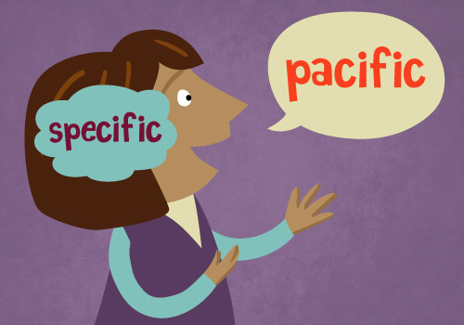
Phonological
awareness
The Phonological core deficit
Ability to mentally break words down into their smallest units of sound (phonemes), to hear these phonemes in isolation (discriminate), chop them off of words (isolate) and to manipulate them (move them around and blend them back together). These skills are a precursor to being able to read and spell with the alphabet.
Without specialist intervention, these difficulties hamstring decoding ability and decoding is the bedrock of fluent reading – the vast majority do not get specialist evidence-based intervention.
From here, the Matthew Effect kicks in…
Much more on this later….

Slide 10
The 4 subcomponents of Dyslexia - the core issues
How quickly and easily objects, pictures, colours, letters or numbers can be recalled aloud - RAN time is a strong predictor of reading ability.
Phonological
awareness
Rapid
Automatized
Naming
(RAN)
Auditory
working
Memory
orthographic
processing
Notes:
Bill

Slide 11
Rapid
Automatized
Naming
(RAN)
Slow Automatized Rapid Naming (RAN)
Refers to how quickly people can retrieve phonological information from long term memory (names of objects, pictures, colours, letters or numbers) and say their names aloud - RAN is a strong predictor of reading ability.
Of course – fast and easy naming of words, morphemes, syllables and letters is critical to fluent reading.
Many studies have shown that Rapid Naming is an area of weakness in many people with dyslexia.
Slow RAN will persist throughout life even if the phonological core deficit has been remediated so, reading will always be slower.

Slide 12
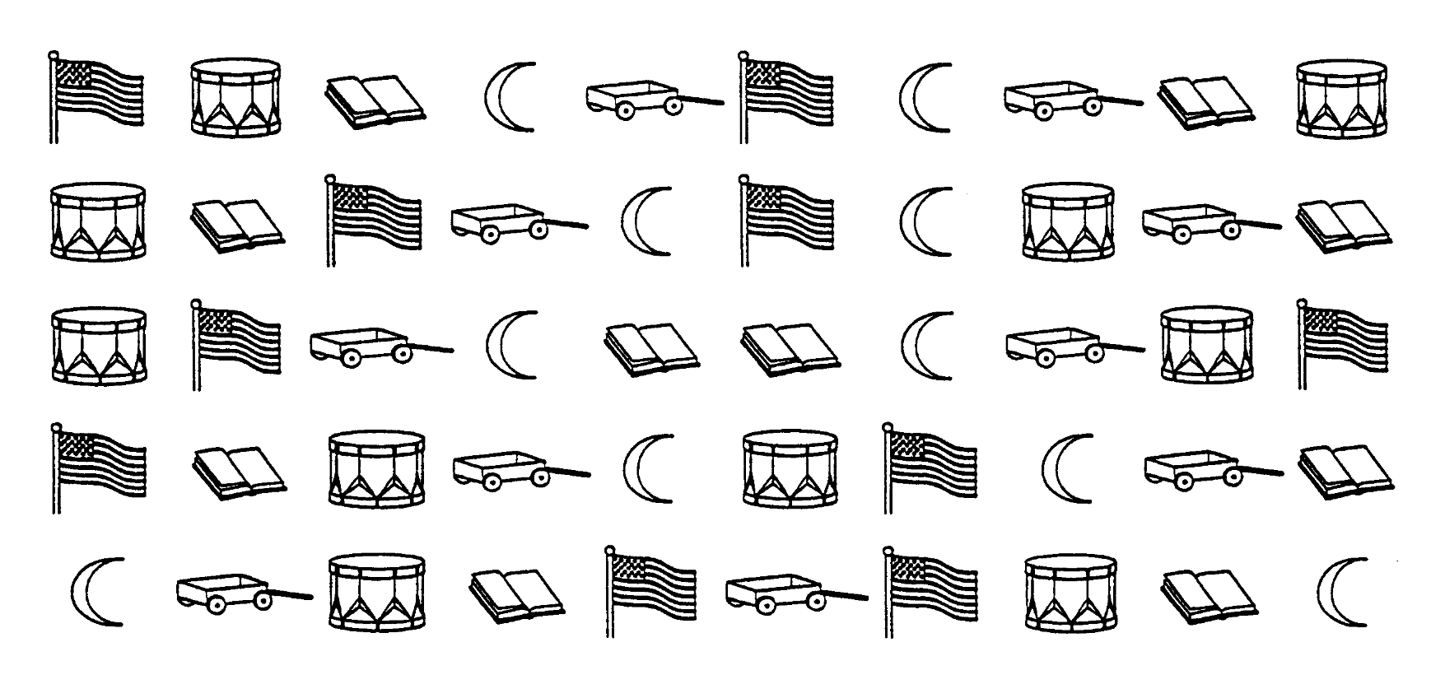
Why do some students struggle to read?
9:21:09 AM
Rapid naming example…
Notes:
Phonological processing skills
3 main skills important for reading
Phonological awareness
Access to sound structure
Elision
Blending
Segmentation
Elision
Phonological memory
Coding info phonologically for temporary storage in working STM
Memory for digits, nonword repetition
Rapid naming
Speed of naming objects, colours, letters

Slide 13
The 4 subcomponents of Dyslexia the core issues
The holding and manipulating of or bits of information (including phonemes) given in the auditory mode (the sound recorder in your head)
Phonological
awareness
Rapid
Automatized
Naming
(RAN)
Auditory
working
Memory
orthographic
processing
Notes:
Bill

Slide 14
Auditory working
Memory
Working memory weakness
the ability to hold in mind and mentally manipulate information over short periods of time. Working memory is like the mental workspace that we use to store important information in the course of our mental activities.
There’s nothing that improves working memory other than understanding it and using strategies to get around its limited capacity.
Children with poor working memory also have problems following lengthy instructions to do one thing after another, because they forget the instruction before the whole sequence of actions has been completed.
Notes:
Bill

Slide 15
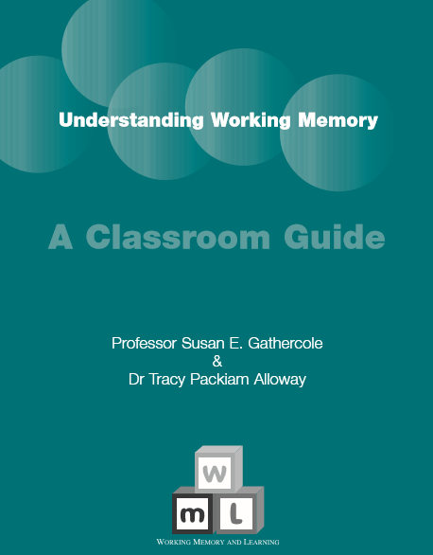
An understanding of working memory is fundamental to good teaching:
This is essential reading
Notes:
Sarah

Slide 16
The 4 subcomponents of Dyslexia - the core issues
The capacity to rapidly and accurately form images of the individual letters and spelling patterns of our language in memory. This includes letter form and orientation, common letter combinations and syllable types.
Does a word
look right …smoke and smoak?
Only a stable orthographic image of the word smoke will help as both are phonologically correct!
Phonological
awareness
Rapid
Automatized
Naming
(RAN)
Auditory
working
Memory
orthographic
processing
Notes:
Bill

Slide 17
orthographic
processing
Poor Orthographic Processing
Ortho - straight
Graph - writing
The capacity to rapidly and accurately form images of the individual letters and spelling patterns of our language in memory. This includes letter form and orientation, common letter combinations and syllable types.
smoke and smoak
Fjursta, comick, ckettle, staj, karrying
Only a stable orthographic image of the word smoke will help as both are phonologically right
Orthographic processing weaknesses show up in spelling.
Notes:
Bill

Slide 18
The capacity to rapidly and accurately form images of the individual letters and spelling patterns of our language in memory. This includes letter form and orientation, common letter combinations and syllable types.
Does a word
look right …smoke and smoak?
Only a stable orthographic image of the word smoke will help as both are phonologically right
Ability to break words down into sounds, to hear the sounds and syllables, be able to discriminate these sounds, and to manipulate them
How fast objects, pictures, colours, letters or numbers can be recalled aloud - RAN time is a strong predictor about reading ability
The remembering of instructions or bits of information (including phonemes) given in the auditory mode (the sound recorder in your head)
Phonological
awareness
Rapid
Automatized
Naming
(RAN)
Auditory
working
Memory
Orthographic
processing
Notes:
Bill

Slide 19
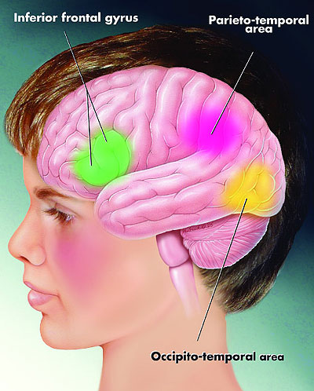
Reading is NOT natural – it’s a neural hack job
The brain is prewired to learn to talk and understand language – there are structures ready to go!
BUT
It was NEVER built for reading
Reading acquisition is NOT a natural process – no reading regions exist
From an evolutionary standpoint, EVERY brain learns to read anew, painstakingly, – from scratch through neuronal recycling (Wolf 2007)

Slide 20
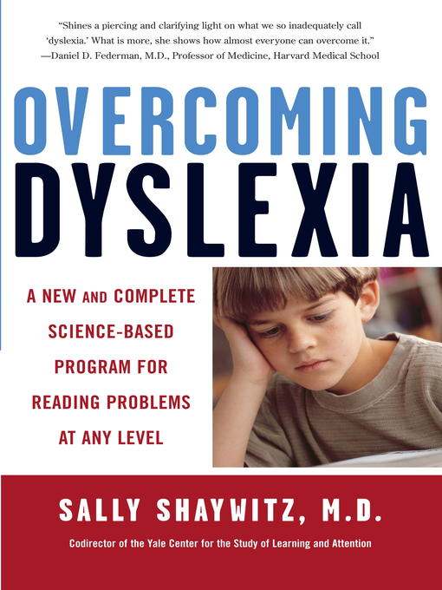
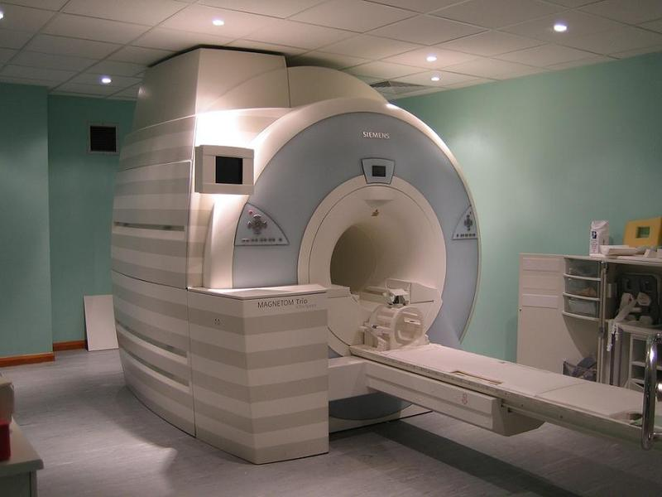
9:26:45 AM

Slide 21
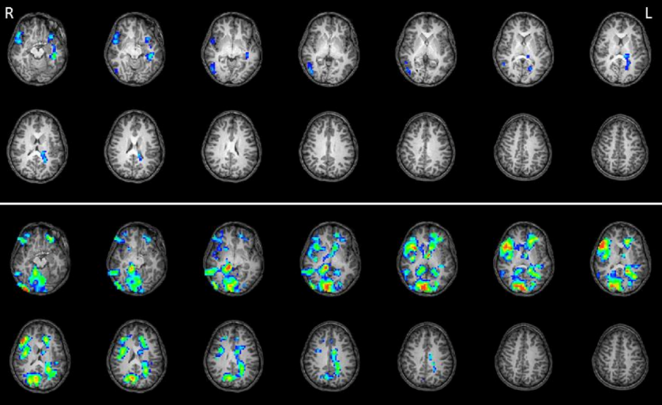
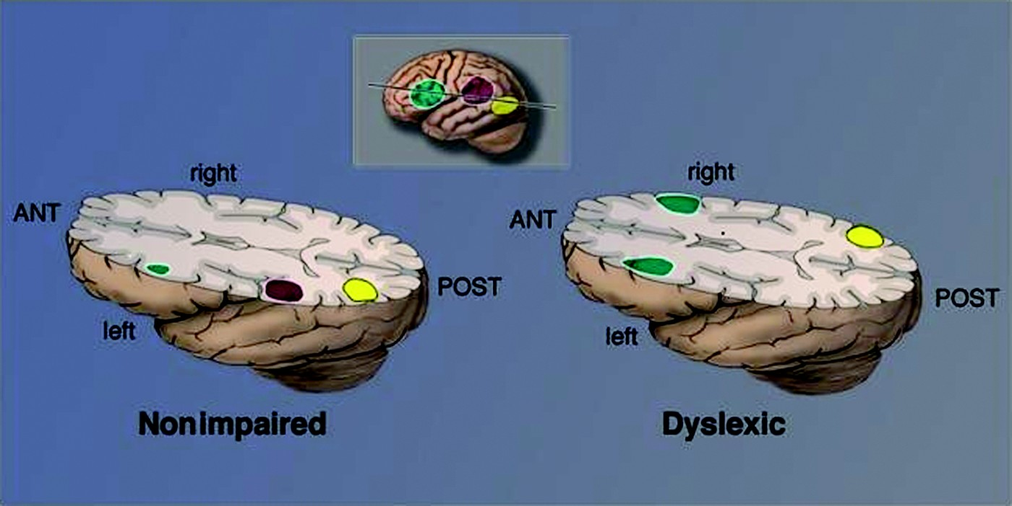
Paying Attention to Reading: The Neurobiology of Reading and Dyslexia
(Shaywitz S.E & Shaywitz B.A.2008)
Development and Psychopathology
Volume 20 / Special Issue 04 / Fall 2008, pp 1329-1349
Copyright © Cambridge University Press 2008
Published online: 07 October 2008

Slide 22
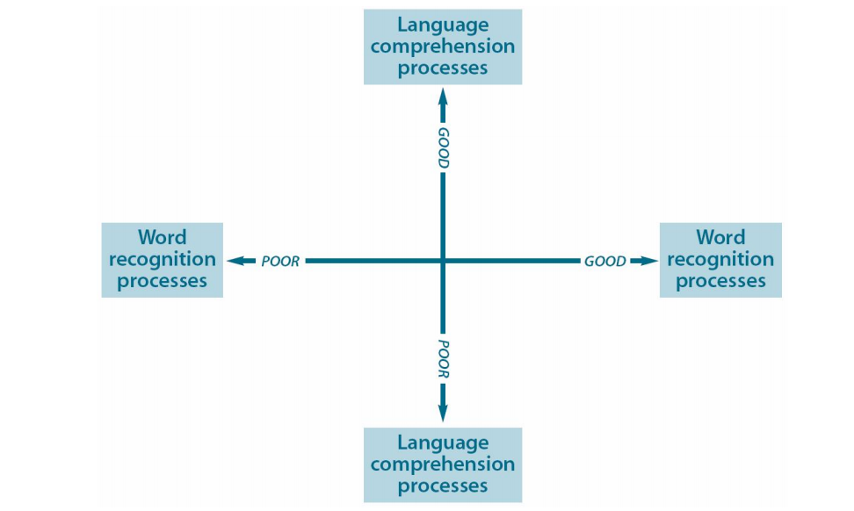
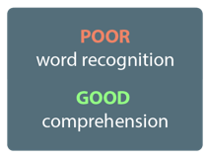
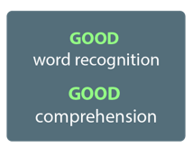
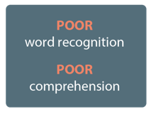
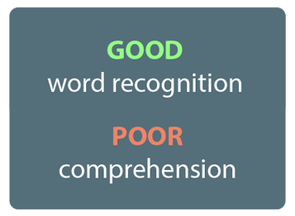
Simple view of reading (after Gough and Tunmer 1986)
DYSLEXIA
Dyslexia is an unexpected cluster of difficulties with the printed word.
Dyslexia masks intelligence and intelligence masks dyslexia.

Slide 23
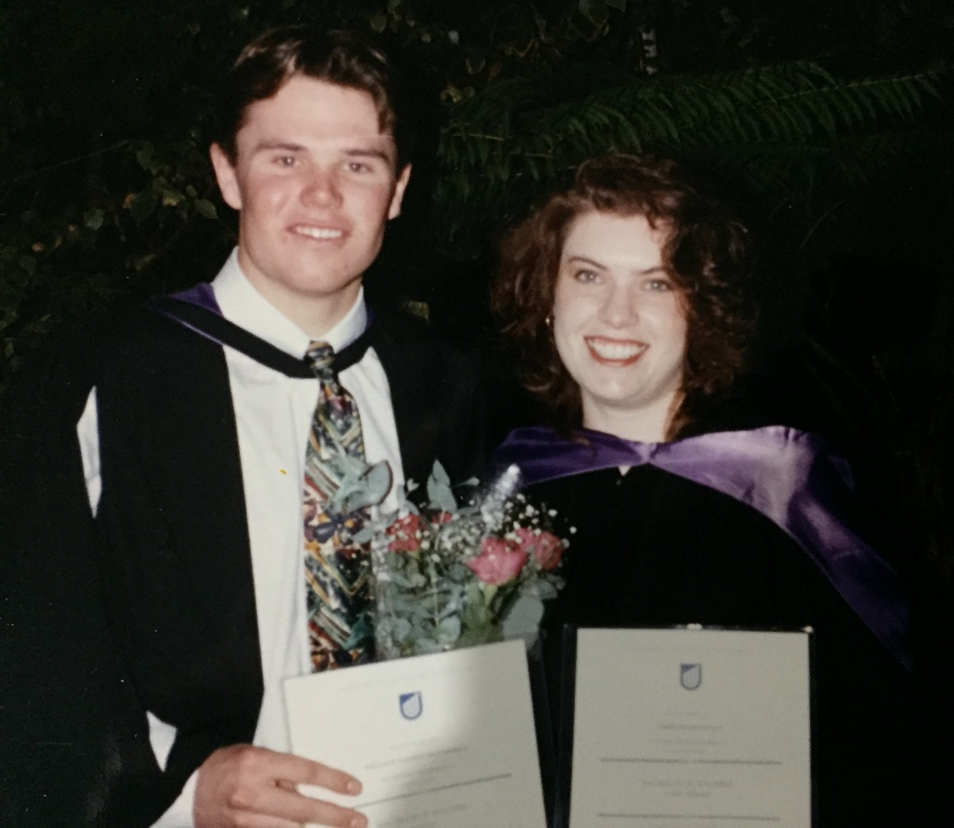
If a teacher’s core business is literacy then why didn’t I hear about some this in University?

Slide 24
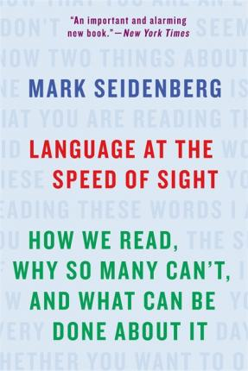
Mark Seidenberg PhD
Cognitive Neuroscientist

Slide 25
Teaching requires a professional model, like we have in medicine, law, engineering, accounting…where consistency of quality is created less by holding individual practitioners accountable and more by building a body of knowledge, carefully training people in their knowledge, requiring them to show expertise before they become licenced and then using their professions’ standards to guide their work (Jal Mehta – Harvard Graduate School of Education)
Teacher education has focused on graduates forming professional identities (253)

Slide 26
The distortions in how science functions in education reflect what happened when an isolated, inbred community of scholars and practitioners developed an arms’ length stance toward research. The field then turns out practitioners who lack the tools to evaluate what they are taught about issues such as how children learn to read. Absent these tools, they are forced to rely on personal experience, or the assurances of authorities, whose reliability is difficult to assess. Or the treacherous Internet, where some experts teach the claims made in the Cmabridge reading hoax as true.
(Seidenberg 1998:286)

Slide 27
Whole language and whole word approaches offer two things that structured literacy doesn’t, and this accounts somewhat for their widespread popularity:
Ease: Teachers do not have to have a great level of expertise to use these approaches, since they are based on children ‘discovering’ how written language works themselves.
Absolution: Children who make low or no progress in reading and writing are labelled within these approaches as having deficits beyond the teachers’ control, such as a language disorder or a social disadvantage
Stone (2019:6) “Reading for Life”

Slide 28
After seeing teaching informed by the REAL science
You might feel confused, angry, indignant, uneasy, conflicted, distressed … people often do…..
“when we know better, we do better”

Slide 29
9:34:55 AM
You’re about to meet colleagues of yours who had these feelings not too long ago.
Amy Smith – Angle Vale Primary School
Anthea Skoumbros – Salisbury Primary School
Carol Scerri – Salisbury Primary School
Ellen Broughton – Salisbury Primary School
Jackie Harker - Angle Vale Primary School
Jen Baird – Salisbury Primary School
Kate Marschall - Angle Vale Primary School
Kim Lester – Salisbury Primary School
Sharon Reed - Angle Vale Primary School
Sharon Rich - Angle Vale Primary School
Tara King – Salisbury Primary School

Slide 30
Let’s sort something out man!
Permanent
word storage is the name of the game
Oral Language
Phonemic Awareness
Phonics (structured, synthetic)
Vocabulary
Fluency
Comprehension
Fluency is the direct result of the number of words you have stored your sight word bank (orthographic lexicon) (30,000 – 70,000 words)
We permanently store words in the orthographic lexicon through a process called Orthographic Mapping (Ehri) Start learning NOW
Orthographic Mapping is absolutely, totally, literally dependent on high level Phoneme awareness skills (phonemic proficiency) and phonic knowledge.
So, brains without phonemic proficiency and phonic decoding skills DO NOT store new words well.
Notes:
You’re very likely of the Big 5 or the big 6 in reading. These are the essential components of reading.
Cover them -
Setting learners’ brains up to be able to permanently store words is what we are trying to do when we teach reading. The process by which brains store words in the sight word vocabulary is called ‘orthographic mapping’, a theory developed by Linea Ehri in the 1980s that is the most supported theory of how brains store words as sight words.
So I guess, we have to clear up what a sight word really is…..
The whole language era did not have the benefit of the convergence of research or the brain imaging we have now that has helped us understand better how a brain learns a word to the point that it is instantly accessible, upon a glance (8/10 of a second). But orthographic mapping is the explainer.
Orthographic Mapping is absolutely, totally, literally dependent on high level Phoneme awareness skills (phonemic proficiency) and phonic knowledge.
So, brains without phonemic proficiency and phonic decoding skills DO NOT store new words well.
What you will see is footage of teaching that goes to work HARD on the non-negotiable components of a writing system where sounds are represented by symbols. Yes, we have a Phoenician alphabet – Phon as a root means ‘sound’ as in ‘phoneme’. Readers must be proficient with working with sounds (phon awareness) and mapping those sounds onto printed symbols (phonics) before we can do the other business of fluency and reading comprehension.

Slide 31
Wave 1
All students
all classrooms
Wave 3
Intensive Multisensory Intervention
Alphabet work
Phonological Awareness
Alphabet work
Phonological Awareness
MSL
Alphabet: often assumed!

Slide 32
The Importance of Teaching Letter Names – Dr. Carol Tolman The knowledge of letter names has been found to be the best predictor of future reading and spelling abilities for children as they enter school even when consideration is given to factors of phonological awareness and intelligence. Because of this research, it is often assumed that adequate focus is given to this important aspect of early literacy development. However, the importance of teaching letter-sound knowledge is sometimes seen as more important than letter-name instruction. Three current articles express why teaching letter naming should remain an important instructional focus.
References:
Foulin, J.N. (2005). Why is letter-name knowledge such a good predictor of learning to read? Reading and Writing. 18, 129-155.
Jones, C. & Reutzel, D. R. (2012). Enhanced alphabet knowledge instruction: Exploring a change of frequency, focus, and distributed cycles of review. Reading Psychology, 33, 448-464.
Piasta, S. & Wagner, R. (2010). Learning letter names and sounds: Effects of instruction, letter type, and phonological processing skill. Journal of Experimental Child Psychology, 105, 324-344.

Slide 33
ALPHABET ACTIVITIES
The dyslexic student needs help in understanding that the letters in the alphabet are symbols representing speech sounds which are ingredients of words. They are the tools of language and need to be learnt by name and in sequential order so they can be located if necessary
The Alphabetic Principle - an insight not gained by many students with dyslexia

Slide 34
UPPER CASE LETTERS (to begin)
Upper Case letters are recommended for these activities because their shapes are less confusing.
b d p q n u
Letters that do not have a recognisable right side are preferred to encourage the student to self correct when letters have been reversed.

Slide 35
At Wave 3 the Alphabet activities predictable and relaxing way to start the lesson and should be short in duration
9:42:40 AM
Learning outcomes:
Familiarization of the names and shapes of the letters
Ability to recite in sequence the alphabet.
Appreciate the position of each letter in the alphabet – find missing letters and go backwards and forwards from any letter.
Understand the concept of accent on syllables.
Exercise and learn memory strategies

Slide 36
Video File: 1.Alphabet
8.53

Slide 37
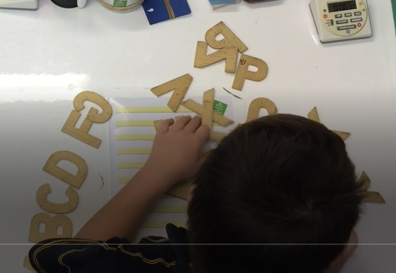
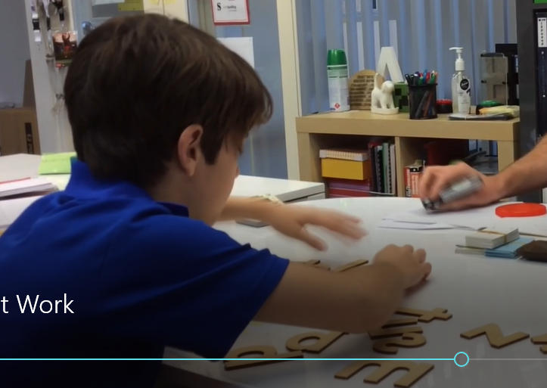
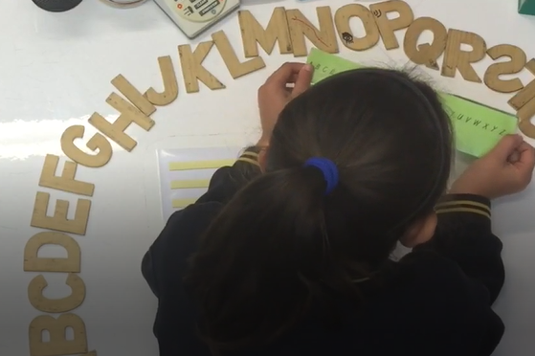
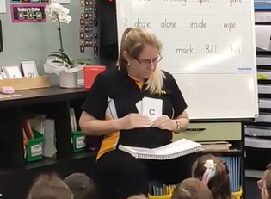
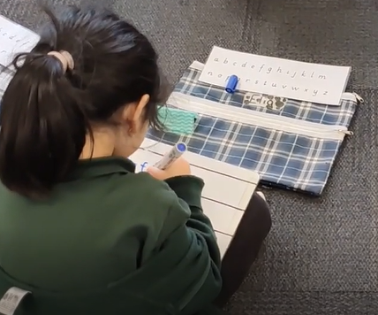
Zack – orientation of upper case still embedding and concepts of before and after have needed lots of work as these concepts are important to spelling rules that Zack has learned that use terms ‘in front’, ‘after’, behind etc.
Archie – in the final stages of memorising lower case alphabet. Quite a way into the Playberry© structure but we’ve kept revising alphabet as we’ve gone along.
Rachael – I was checking that she is corresponding letter names to letters and then did some orientation work with her where I reversed some letters for her to fix.
Sharon’s Receptions – doing a letter naming drill with mixed case. Sharon was watching carefully!
Kim’s Receptions – writing the alphabet with Kim saying sounds and the students writing lower case letters

Slide 38
9:53:40 AM
Wave 1
All students
all classrooms
Wave 3
Intensive Multisensory Intervention
Alphabet work
Phonological Awareness
Alphabet work
Phonological Awareness
MSL
Phonological Awareness

Slide 39
Phonological Awareness
If you don’t got it, you won’t do literacy good!
Notes:
I’m going to leave no stone unturned here in making sure you understand the importance of PA to reading and spelling.

Slide 40
Phonological Awareness do it in the dark!
Phonological Aswareness do it in the dark!
Segment, isolate, delete
Segment, isolate, manipulate
Segment rime unit, manipulate
Segment, isolate, manipulate, blend
Segment, isolate, delete, blend
Segment, isolate, reverse, blend
Segment, isolate, manipulate, blend
Segment, isolate, manipulate, blend.
Say ‘spit’
Say ‘spit’ without the /s/
Say ‘pit’, change the /p/ to /sh/
Now change the rime unit /it/ to /ap/
Say ‘shap’
Now change the /sh/ to /cr/
Now delete the /r/
Say ‘cap’. Now say it backwards
Say ‘pack’, instead of /ă/ say /ŭ/
Now instead of /p/ say…..
/d/

Slide 41
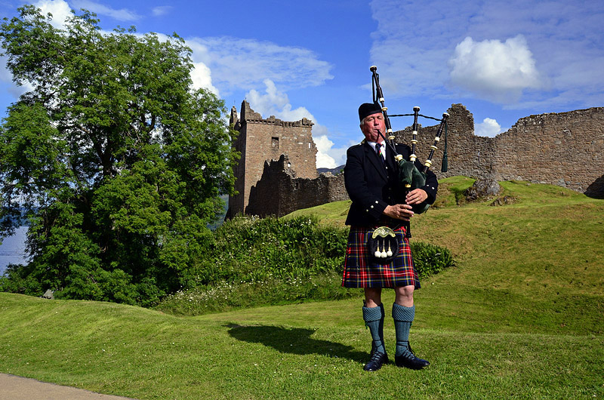
Time for ‘wee’ break
9:57:01 AM
back in 10 sharp

Slide 42
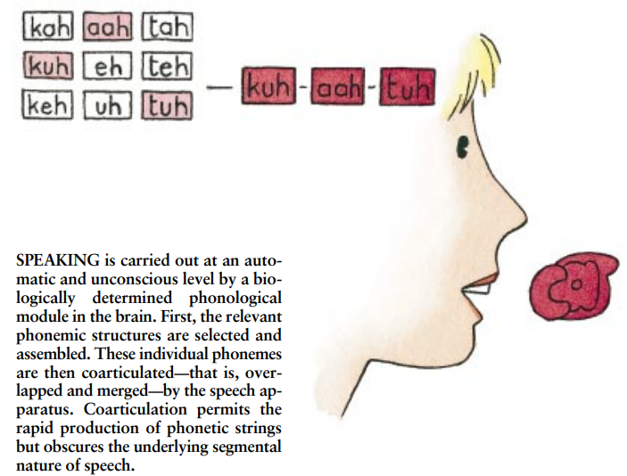
Advanced PA didn’t matter so much until some jerk invented writing!
10:07:01 AM
http://www.cogsci.ucsd.edu/~coulson/CNL/shaywitz-dyslexia.pdf

Slide 43
Dat’s phoneme segmentation and isolation baybee!
ă
c
t

Slide 44
HIERARCHY OF PHONOLOGICAL AWARENESS SKILLS
Segment compound words
segment syllables
Alliteration – initial and final phonemes
Onset and rime segmentation
Segment initial and final phonemes
Blending phonemes into words (moosh)
Segmenting words into phonemes (chop)
Delete / add / substitute phonemes
Proficient, not just accurate (Kilpatrick)

Slide 45
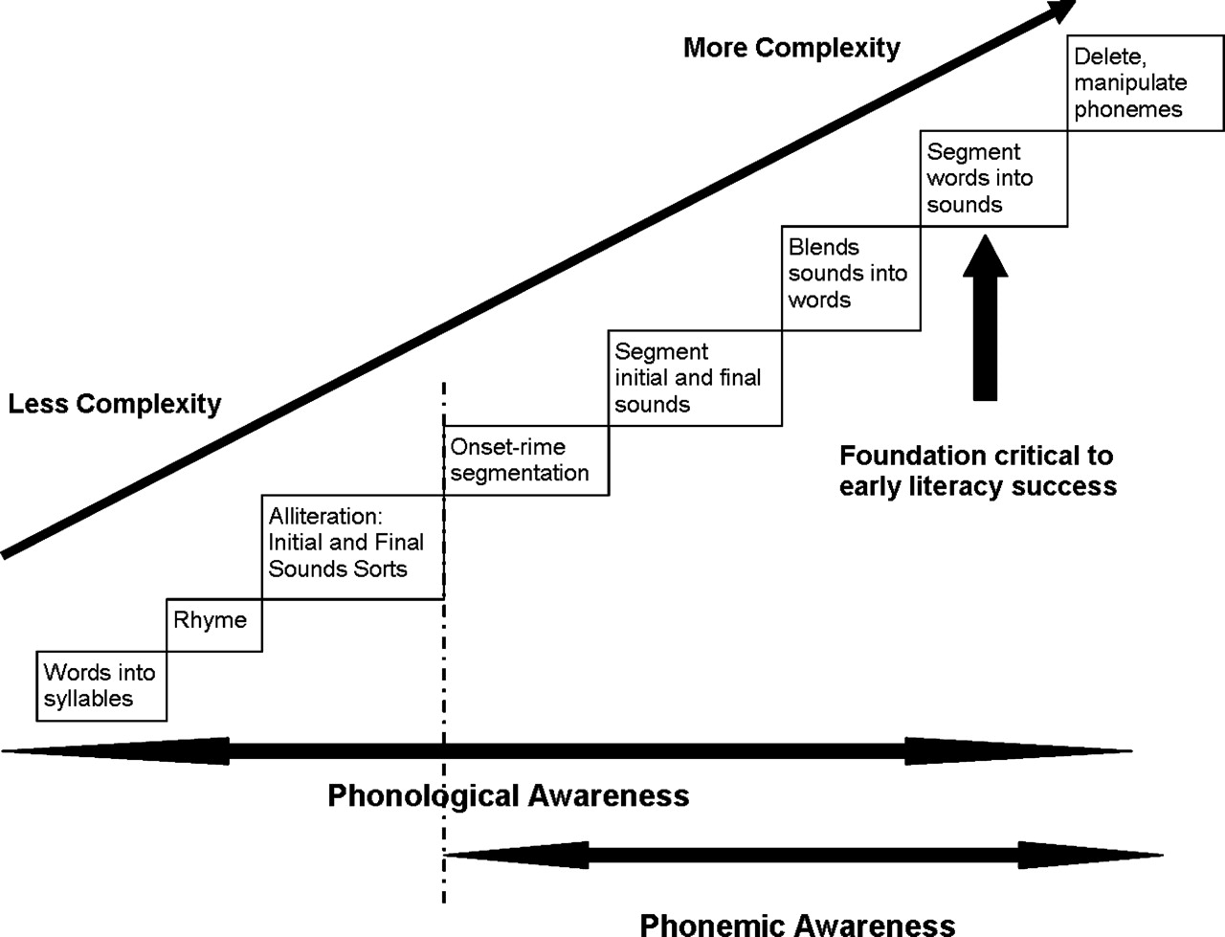
Phonological Awareness
Notes:
Here’s the ladder, or staircase of Phonological awareness skills. The easier stuff at the bottom, the complex stuff at the top,

Slide 46
Let’s watch some phonological awareness work at wave 1,2 and 3.
Your Task:
Take a screen shot of the PA ladder (previous slide) or Google ‘phonological awareness ladder’ and park it where you can see it
As you watch, see if you can identify the levels being worked on – with the classroom footage there’s a lot going on!

Slide 47
Video File: 2.Phon Awareness
7:45

Slide 48
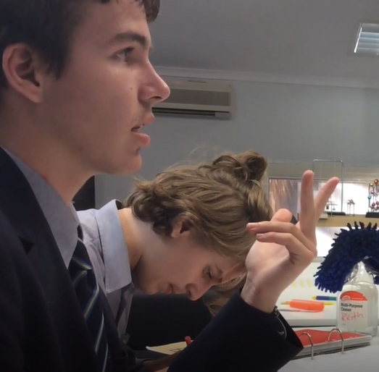
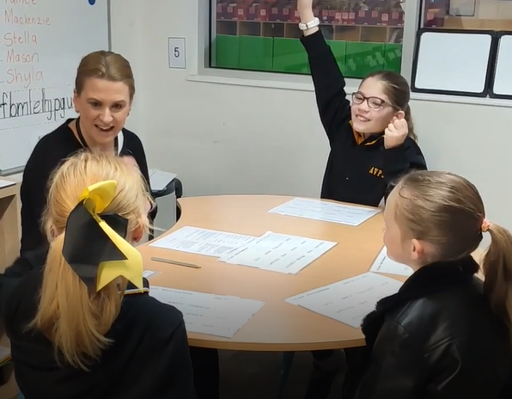
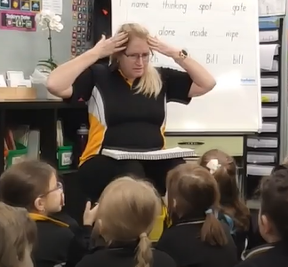
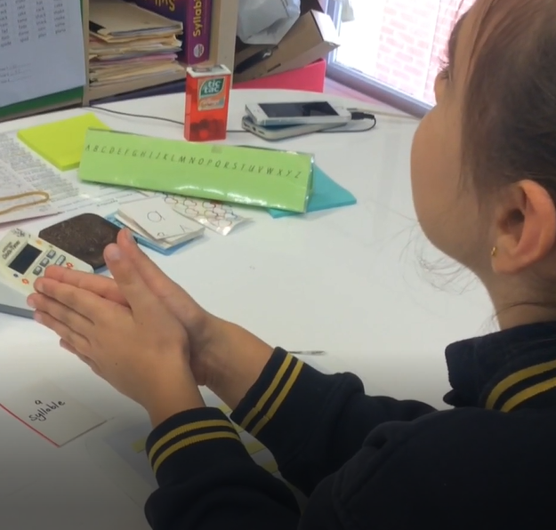
10:20:42 AM
WAVE 3
WAVE 2
Manipulate phonemes
Words into syllables
(had a phonic component)
WAVE 1
WAVE 3
Rhyming
Blend compound words
Segment initial / final sounds
Words into syllables
Manipulate phonemes
Segment words into sounds
Words into syllables
Manipulate phonemes (had a phonic component as Rachael was looking at letters)
Notes:
How did you go placing what you saw on the phonological awareness spectrum?
CLICK:
Matt and I were working at a high level using Kilpatrick’s one minute activities – we were at level L2, the highest is N, so Matt wat was on the cusp of moving into high level phonological processing tasks where he’ll be practicing deleting and substituting internal phonemes in ending blends:
Say ‘coast’ , now without the (s) = coat
Say ‘desk’ , now without the (s) = deck
Say ‘lift’, now change the (f) to (s) = list
Say ‘paint’, now change (n) to (s) = paste
We are aiming for proficiency at tasks – this means they do the task without cognitive effort (pre cognitively). In Matt’s case, in under 2 seconds. This is different to being ‘accurate’, where they get it after some effort, or have to use a multisensory scaffold like the fingers.
CLICK:
Sharon had her receptions using one of the Heggerty manuals that offered up a range of tasks that fall up and down the spectrum of difficulty from producing rhyme to swapping vowels in front of ‘ng’. These exercises are deliberately put together this way to capture the range of PA abilities and an experienced teacher (like Sharon) will watch the kids to see who’s responding confidently and who looks lost.
CLICK:
Jackie was working at wave 2 with this small group on identifying syllables – there was a phonics component here as the kids were looking at the word ‘hopscotch’ as they counted syllables
CLICK:
Rachael and I were working at wave 3 on syllables and then moved on to adding a phoneme to words (again, there was a phonics component here as Rachael could see the words, however, she still had to add the phoneme.
Notice in the last 2 clips, there was confusion about the difference between a phoneme and a syllable – this is common and needs reteaching often.
CLICK:
So we have Phonological awareness work going on across all waves as it’s a non-negotiable element of reading and spelling. We always give the instruction at the level required, regardless of the student’s age and move them along when they are PROFICIENT at that level.

Slide 49
Wave 1 Phonological Awareness Training GUESS: what percentage fewer kids will need intervention if all classes did what you saw Sharon’s receptions do?
David (Guru) Kilpatrick
50-75% reduction in students needing later intervention in reading

Slide 50
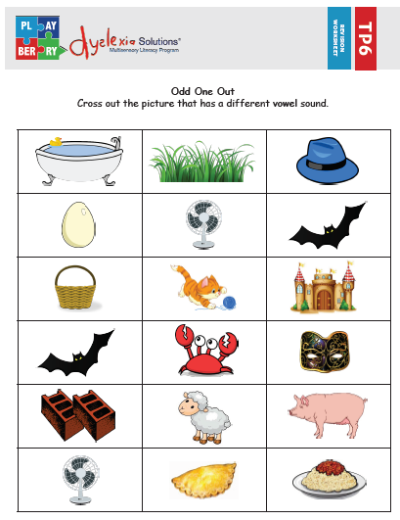
10:29:03 AM
What’s the PA Skill Level?
Segment compound words
segment syllables
Alliteration – initial and final phonemes
Onset and rime segmentation
Segment initial and final phonemes
Blending phonemes into words
Segmenting words into phonemes
Delete / add / substitute phonemes

Slide 51
What’s the PA Skill Level?
Segment compound words
segment syllables
Alliteration – initial and final phonemes
Onset and rime segmentation
Segment initial and final phonemes
Blending phonemes into words
Segmenting words into phonemes
Delete / add / substitute phonemes

Slide 52
What’s PA the Skill Level?
Segment compound words
segment syllables
Alliteration – initial and final phonemes
Onset and rime segmentation
Segment initial and final phonemes
Blending phonemes into words
Segmenting words into phonemes
Delete / add / substitute phonemes

Slide 53
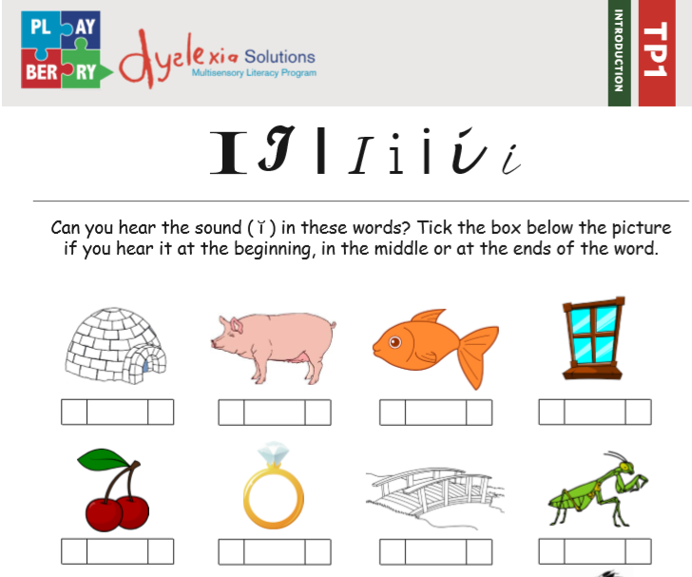
What’s the PA Skill Level?
Segment compound words
segment syllables
Alliteration – initial and final phonemes
Onset and rime segmentation
Segment initial and final phonemes
Blending phonemes into words
Segmenting words into phonemes
Delete / add / substitute phonemes

Slide 54
Why we must care about kids being able to ch/o/p words up
Phonemic awareness
#1 Predictor of future reading success
Non-negotiable, critical role in beginning of accurate and automatic word reading. It is the BASE that all other critical reading components builds on.
‘Phoneme vs Phonological Awareness: Knowing the Difference Matters for Assessment and Instruction’ Maria S Murray PhD. (The Reading League)

Slide 55
Phonemic awareness #1 Best Predictor or reading success or failure (behind genetics)
NOT their visual memory, not their exposure to print, not their breadth of vocabulary….
Kids need to be able to tear words down into their smallest bits (phonemes)
In words, phonemes are mooshed together
Working with a Phoenician alphabet requires we be able to break words down into their phonemes and then put them back together again
The Alphabet is just pictures of our phonemes

Slide 56
10:33:04 AM
www.fivefromfive.org.au
Notes:
1:26

Slide 57
Wave 1
All students
all classrooms
Wave 3
Intensive Multisensory Intervention
MSL
Alphabet work
Phonological Awareness
Alphabet work
Phonological Awareness
Phonics review
to structure
Grapheme
Phoneme
Phonics Drills
to structure
Grapheme
Phoneme
Concepts review
to structure
Concept Drill
to structure
Grammar, spelling rules, morphology
Explicit Direct Instruction
Grammar, spelling rules, morphology
Activate prior learning
Activate prior learning
Revision
to structure
Fine grained, diagnostic teaching
Revision task
to structure
New Teaching
to structure
New Teaching
to structure
Game
to structure
Grapheme-Phoneme drills, concept drills: quick-fire review

Slide 58
Video File: 3. GPC Drills (0:00-06.16)

Slide 59
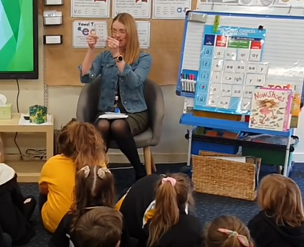
Did you keep up with the year 1s?
‘eigh’ for (ā) usually followed by ‘t’ like with ‘igh’
‘th’ voiced and unvoiced
‘oe’ spells (ō) on the end of short words
‘i’ spells (ī) on the end of open syllables
Suffix ‘ed’ forms past tense and has sounds (Əd), (t), (d)
‘k’ in front of e, i, or y
‘ck’, ‘ff’, ‘ll’, ‘ss’ after a short vowel and the ends of short words (floss)
‘qu’ best friends
‘dge’ spells (j) after short vowels on ends of short words
‘tch’ same right!!!
‘ay’ spells (ā) on the end (positional frequency)
‘-nk’ with a PA task thanks very much
‘ear’ hear the earth
‘g’ hard and soft sounds with the rule!
Vowel consonant ‘e’ PA task:

Slide 60
a - e
e - e
i - e
o - e
u - e
“Dat’s phoneme manipulation and blending baybee!”

Slide 61
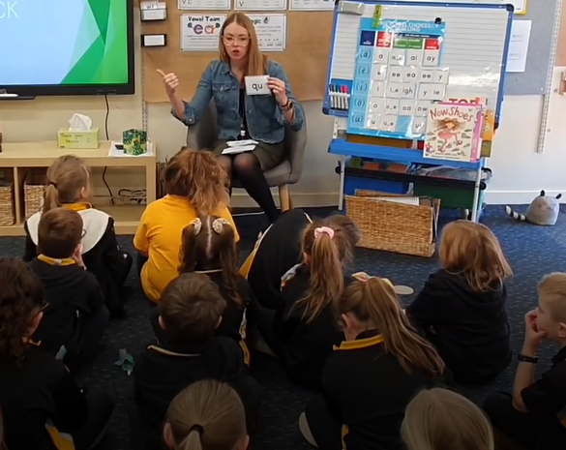
Did you keep up with the year 1s?
‘eigh’ for (ā) usually followed by ‘t’ like with ‘igh’
‘th’ voiced and unvoiced
‘oe’ spells (ō) on the end of short words
‘i’ spells (ī) on the end of open syllables
Suffix ‘ed’ forms past tense and has sounds (Əd), (t), (d)
‘k’ in front of e, i, or y
‘ck’, ‘ff’, ‘ll’, ‘ss’ after a short vowel and the ends of short words (floss)
‘qu’ best friends
‘dge’ spells (j) after short vowels on ends of short words
‘tch’ same!
‘ay’ spells (ā) on the end (positional frequency)
‘-nk’ with a PA task thanks very much
‘ear’ hear the earth
‘g’ hard and soft sounds with the rule!
Vowel consonant ‘e’ PA task:
Hard and soft ‘c’
‘e’ long and short (it’s long in an open syllable)
‘y’ consonant and vowel sounds: (ĭ) on the end of long words, (ī) on the end of short words!
$$f\left(x\right)=a_{0}+\sum_{n=1}^{∞}{\left(a_{n}\cos{\frac{nπx}{L}}+b_{n}\sin{\frac{nπx}{L}}\right)}$$

Slide 62
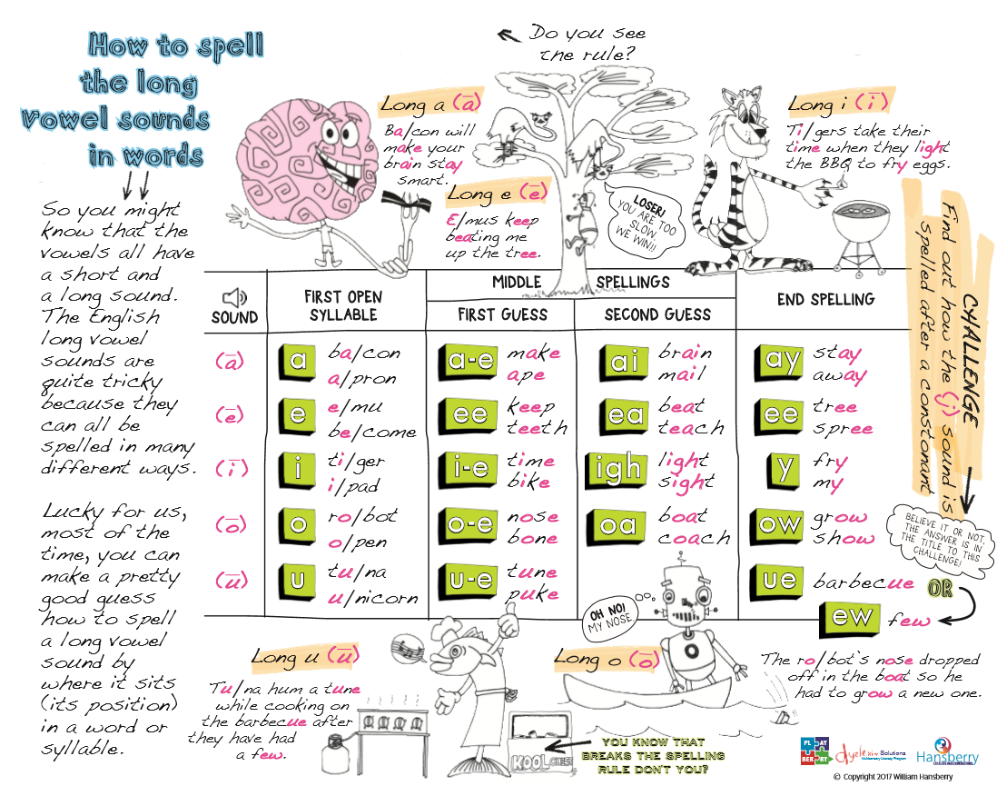
10:40:30 AM
Positional frequency of long vowel spellings – heeps worth teeching

Slide 63
Video File: 3.GPC Drills (06.16 - end)

Slide 64
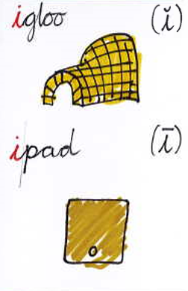
Tier 3 Reading Card Drill Grapheme(s) to Phoneme(s)
See Grapheme
/ Phonogram
Produce clue words and isolate and articulate the target phoneme(s)

Slide 65
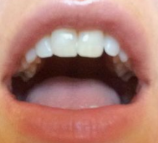
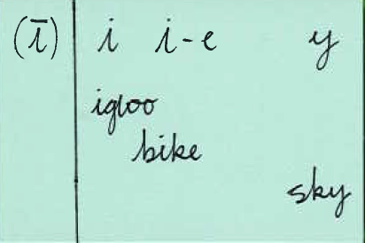
Tier 3 Spelling Card Drill Phoneme(s) to Grapheme(s)
10:45:30 AM
ī is ‘i’
ipad
ī is ‘i’ consonant ‘e’
ī is ‘y’
Repeat target phoneme, match to graphemes and write
Hear target phoneme

Slide 66
Wave 1
All students
all classrooms
Wave 3
Intensive Multisensory Intervention
MSL
Alphabet work
Phonological Awareness
Alphabet work
Phonological Awareness
Phonics review
to structure
Grapheme
Phoneme
Phonics Drills
to structure
Grapheme
Phoneme
Concepts review
to structure
Concept Drill
to structure
Grammar, spelling rules, morphology
Explicit Direct Instruction
Activate prior learning
Activate prior learning
Grammar, spelling rules, morphology
Revision
to structure
Fine grained, diagnostic teaching
Revision task
to structure
New Teaching
to structure
New Teaching
to structure
Revision
Game
to structure

Slide 67
Video File: 4.Revision
10:32

Slide 68
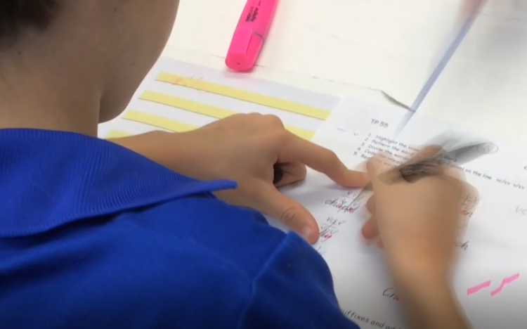
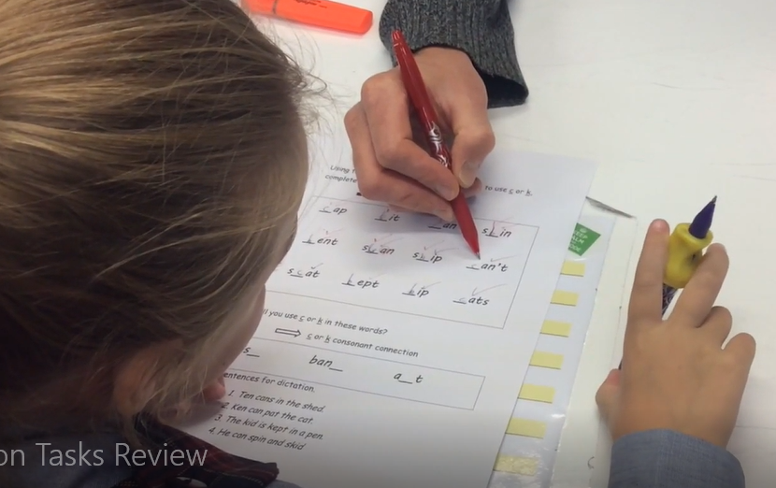
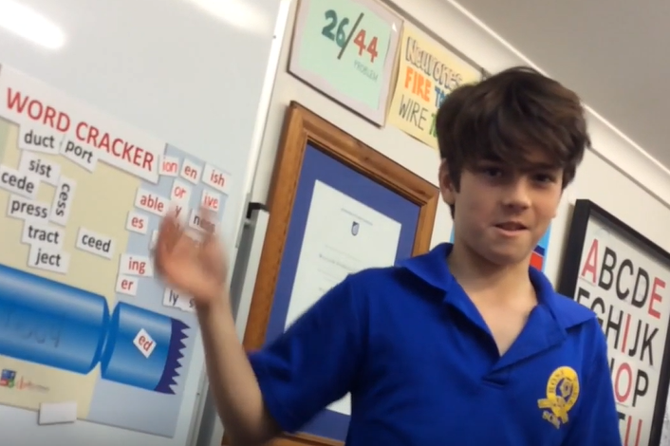
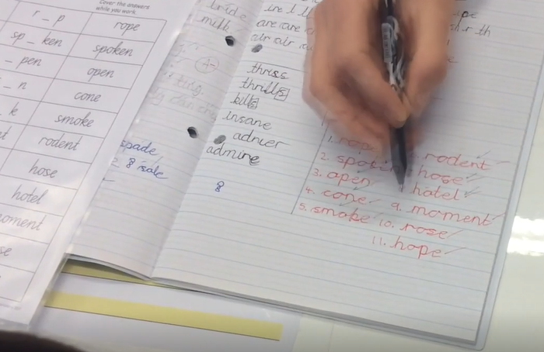
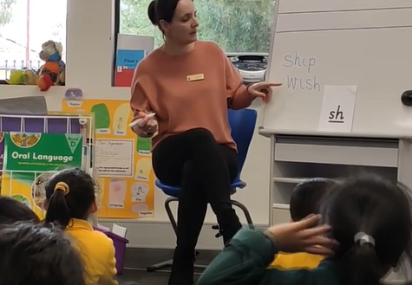
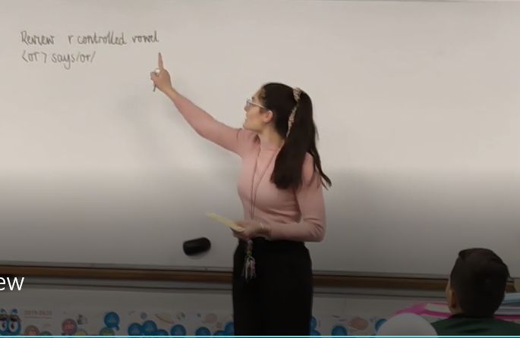
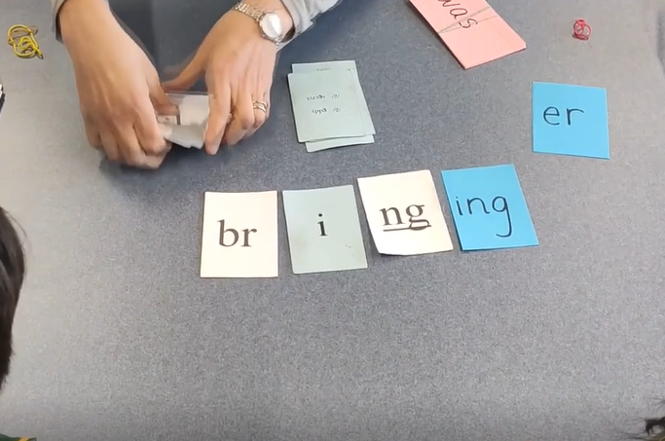
Archie – Patterning, dividing and coding activity: word study that trains the brain to identify syllable divisions through the common patterns (VC.CV, V.CV, VC.V and V.V) and to code vowel sounds using diacritical markings
Ava – practising two different graphemes for the sound (k) using her spelling rules for ‘c’, and ‘k’
Archie – Using The Word Cracker to embed morphology concepts
Jake – practising orthographic choice with ‘o’ and ‘o-e’ for long (ō) with a Playberry© tutor sheet and doing a reading exercise where he’s learning to quickly read a-e and closed syllables with the short (ă) phoneme.
Kim’s Receptions – reviewing ‘sh’
Anthea’s 4/5s – reviewing ‘or’ r-controlled spellings
Tara (wave 3) – practising blending of previously taught phonograms and ‘wa’ words

Slide 69
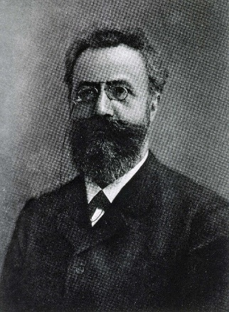
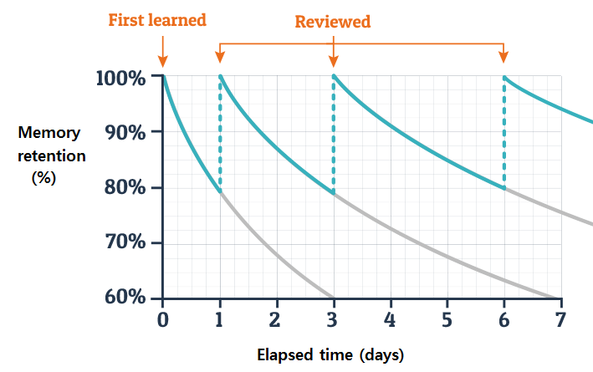
Spaced, Interleaved Retrieval Practice

Slide 70
Time for ‘wee’ break
10:59:12 AM
back in 10 sharp

Slide 71
Wave 1
All students
all classrooms
Wave 3
Intensive Multisensory Intervention
MSL
Alphabet work
Phonological Awareness
Alphabet work
Phonological Awareness
Phonics review
to structure
Grapheme
Phoneme
Phonics Drills
to structure
Grapheme
Phoneme
Concepts review
to structure
Concept Drill
to structure
Grammar, spelling rules, morphology
Explicit Direct Instruction
Activate prior learning
Activate prior learning
Grammar, spelling rules, morphology
Revision
to struture
Fine grained, diagnostic teaching
Revison task
to structure
New Teaching
to structure
New Teaching
to structure
New Teaching to structure
Game
to structure

Slide 72
Video File: 5.New Teaching
10.53

Slide 73
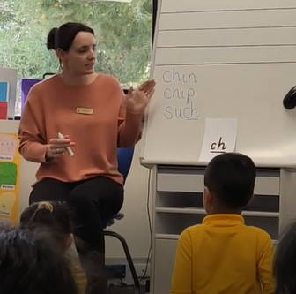
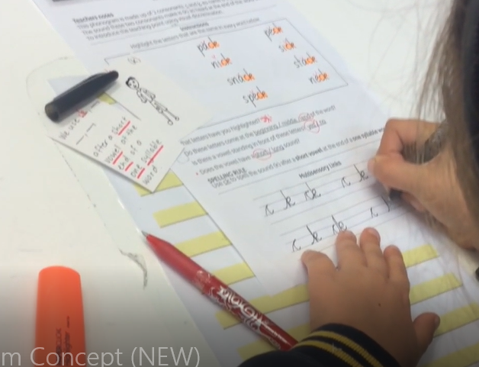
Kim’s Receptions – teaching ‘ch’ though EDI “I do, we do, you do’ model with multisensory component
Rachael – learning ‘ck’ and doing multisensory links
Zack – Learning about the suffix ‘s’ and how it makes nouns plural and helps verbs work in sentences on The Word Cracker
Jake – learning that ‘ore’ is a common spelling of the phoneme (or) on the ends of words through Directed Discovery Teaching
Anthea’s 4/5s – decoding and encoding the different spellings for sound (or) with a focus on ‘au’ grapheme
Ellen’s 6/7s – reviewing morphology and then learning the root ‘struct’
Jen’s class – vocabulary lesson – word ‘beckoning’ – chosen from a class novel

Slide 74
Wave 1
All students
all classrooms
Wave 3
Intensive Multisensory Intervention
MSL
Alphabet work
Phonological Awareness
Alphabet work
Phonological Awareness
Phonics review
to structure
Grapheme
Phoneme
Phonics Drills
to structure
Grapheme
Phoneme
Concepts review
to structure
Concept Drill
to structure
Grammar, spelling rules, morphology
Explicit Direct Instruction
Activate prior learning
Activate prior learning
Grammar, spelling rules, morphology
Revision
to struture
Fine grained, diagnostic teaching
Revison task
to structure
New Teaching
to structure
New Teaching
to structure
Game to structure
Game
to structure

Slide 75
Interviews with Teachers and Leaders
11:24:35 AM
How did Dyslexia inform or change the teaching here?
How did you go with getting the reading research into the classroom and into teacher knowledge?
Talk about your move from levelled, predictable readers to decodable readers
What about the kids who didn’t get the evidence-based instruction from the start of school and What has this meant for intervention?
How are you affording this?
Explicit teaching, drill and repetition…old hat or just what learning requires?
What about complex students from complex backgrounds?
Schools usually go looking for programs, you went looking for staff professional development – why?
How have you (leadership) helped teachers manage the transition?
Moving from ideology about reading to teaching based scientific evidence
MSL

Slide 76
Video File: 6.Interviews
27.05

Slide 77
Q&AA *AA = Attempted answer

Slide 78
www.hansberryec.com.au
Hansberry Educational Consulting
@BillHansberry

Slide 79
Lawson Hansberry
My wonderful kids at Fullarton House:
Archie, Ben, Matt, Jake, Zack, Rachael and Ava
Staff and students at:
Angle Vale Primary School
Salisbury Primary School
And
The other schools who’ve decided that literacy is too important not to uncomfortably re-examine what they teach and how they teach it. Literacy for all is a social justice!
MSL
Fangs!

